Slide 1
The “Lightness” of Industry 4.0 Lead Firms: Implications for GVCs
Presentation to the
Globalization, Regional Growth and the 4th Industrial Revolution Conference
Bologna, Emilia-Romagna
Italy
Lukas Brun
Gary Gereffi
James Zahn
October 20, 2017

Slide 2
Agenda
What is a GVC?
What are the effects of digitization on GVCs?
Supply chain effects
Rise of new lead firms
What are the characteristics of digital economy MNEs?
“Lightness” defined
Lightness across and within industries
Three scenarios for digital transformation and GVC lead firms

Slide 3
What is a value chain?
“A value chain describes the full range of activities that firms and workers carry out to bring a product from its conception to its end use and beyond.”
Notes:
What is a value chain?
A value chain describes the full range of activities that firms and workers perform to bring a product or service from its conception to its end use. Activities such as design, production, marketing, distribution and support to the final consumer are included in a value chain.
The activities that comprise a value chain can be contained within a single firm or divided among different firms, and can be contained within a single geographical location or spread over wider areas.
A value chain can be used to examine the job descriptions, technologies, regulations, products, processes, and markets in specific industries, providing a flexible and holistic view of global industries, and the role of a specific region or company within them.
[Illustration]
Production is global. Here is an example of the supply chain partners for the Boeing 787. Bottom line: for most commodities most of the time, to produce you must import. And to export you must import.

Slide 5
The GVC Framework
Major components of the framework
Analytical Sections
Input-output structure: raw materials → inputs → final product
Geographic scope: local to global
Analysis of lead firms and governance
Institutional framework: rules, forums of exchange, and key organizations
Mapping the Global Value Chain
Geographic Distribution (global demand, global supply)
Lead firms and governance
Standards and institutions
Human capital and workforce development
Upgrading trajectories

Slide 6
Global Value Chains
Global perspective
Organization of entire industries: raw materials to production to final sale & beyond
Linkages across firms and countries – coordination and integration
Power in the chain (drivers)
Upgrading (development) opportunities

Slide 7
Recent Trends in GVCs
Rationalization
Regionalization
Resiliency
Sustainability
Digitization – focus of paper

Slide 8
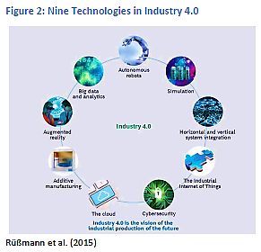
Industry 4.0 Technologies

Slide 9
What’s changed?
Source: Mussomeli et al. (2016)

Slide 10
Effects of Industry 4.0 technologies on production systems
Distributed production
Localized manufacturing closer to the point of consumption
Factory replication (digital twins) under centralized control
Flexible production
Automation supports:
Production to order (volume flexibility)
Accelerated servicification
Product servicifaction (“power-by the hour”)
Increased use of contract manufacturing and outsourcing of ancillary operations across more industries
Customization (increased product variety)
Extended disintermediation
Direct delivery of products and services to end users
Branded manufacturers reaching to end users
Source: UNCTAD (2017) World Investment Report: Investment and the Digital Economy, p.181

Slide 11
The effects of digitization on value chains
Upstream/
supplier relations
Internal production processes
Downstream/ customer relations
End-to-end processes
E-auctions, with open or closed systems
Suppler or vendor managed inventory
Collaborative product or production process design
Digitally enabled automation of factory operations
Production closer to consumption
Advanced digitally enabled manufacturing technologies (3D printing, continuous processing)
Disintermediation in product delivery and distribution models; monitoring of product use by end user
Digitally enabled product customization
Mass connectivity between customers and suppliers
Transparency and traceability; digital quality and compliance systems
Big-data predictive supply chains
Use of new data management providers and system integrators
Distributed production
Distributed & flexible production
Disintermediation;
Servicification
Servicification
Source: UNCTAD (2017) World Investment Report: Investment and the Digital Economy, p.180

Slide 12
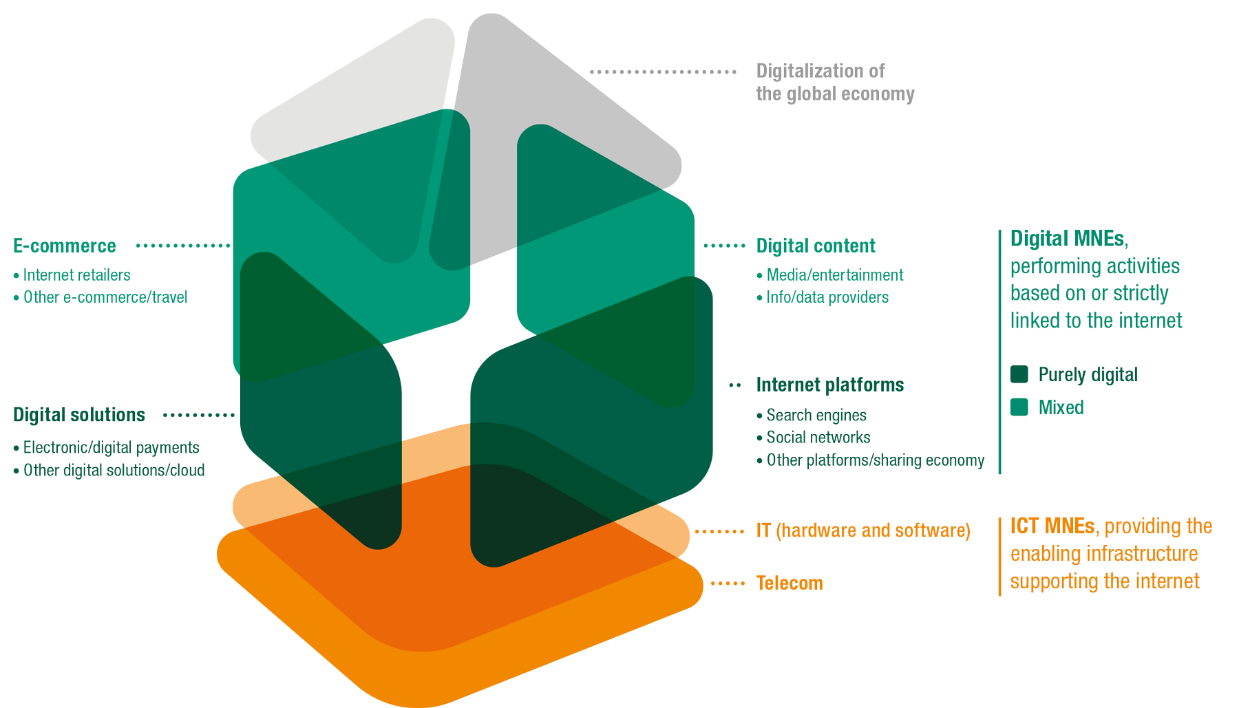
The Architecture of the Digital Economy
Source: UNCTAD (2017) World Investment Report: Investment and the Digital Economy, p.167

Slide 13
Digital Economy Lead Firms
Source: UNCTAD (2017) World Investment Report: Investment and the Digital Economy, p.167

Slide 14
Characteristics of Digital Economy MNEs
Fast growing (2010-2016 revenue growth > 5% CAGR v. -2% all others)
Large cash reserves kept overseas (“tax efficiency”)
Concentration of productive investment in a few developed economies
Limited international asset footprint relative to foreign sales (“lightness”)

Slide 15
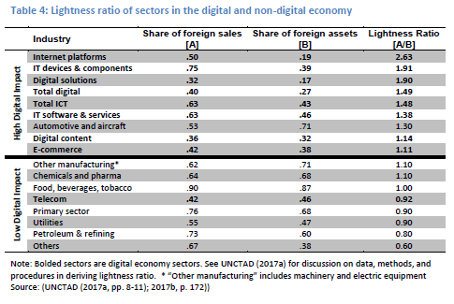

Slide 16
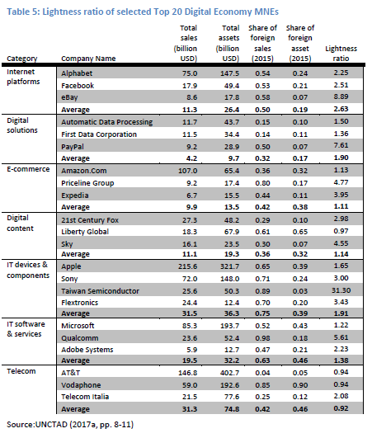

Slide 17
Digitalization and Development: conclusions
Digitalization changes supply chains
Supply chain changes have development effects
employment and skills implications (not just automation)
FDI implications (i.e., efficiency seeking FDI v. knowledge seeking FDI)
New lead firms (digital economy MNEs) have a different business model
Uncertain whether it will migrate to producer and buyer-driven GVCs
Not all digital economy firms are the same in terms of “lightness”
“Heavier” firms
Notes:
Digitalization changes supply chains
Distributed and flexible production
Accelerated servicification
Extended disintermediation
Supply chain changes have development effects
employment and skills implications – we have heard a lot about the employment effects of automation, but what about servicification and disintermediation? We have also heard a lot about the employment implications of manufacturing versus other sectors of the economy, but what about differences in manufacturing sectors, for example,
FDI implications
New lead firms (digital economy MNEs) are emerging that have a different business model
Uncertain whether different business model will migrate to producer and buyer-driven GVCs
Not all digital economy firms are the same

Slide 18
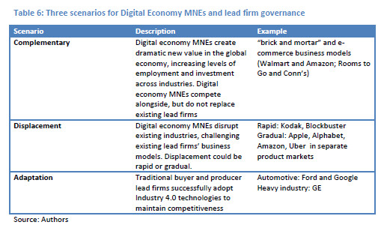

Slide 19
Thank You!
Lukas C. Brun
lukas.brun@duke.edu

