Slide 1

New industrial and trade dynamics in a changing world
Annalisa Primi
Head, Structural Policies and Innovation Unit, OECD Development Centre, Paris-France
annalisa.primi@oecd.org
Globalisation, human capital, regional growth and the 4th Industrial Revolution
Bologna, 20 October 2017

Slide 2
GVCs made new actors entering in global trade dynamics
CLIMBING the LADDER
DEEPENING in ASSEMBLY
GROWING EMPLOYMENT
DECLINING EMPLOYMENT
CONTROLLING the VC
Source: OECD Development Centre- UNCTAD- ECLAC-ECA-ESCAP- Transforming Economies Report (forthcoming based on World Bank World Development Indicators, 2016).

Slide 3
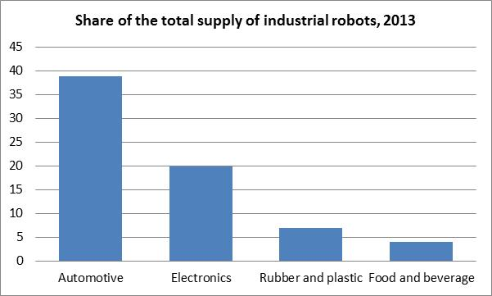
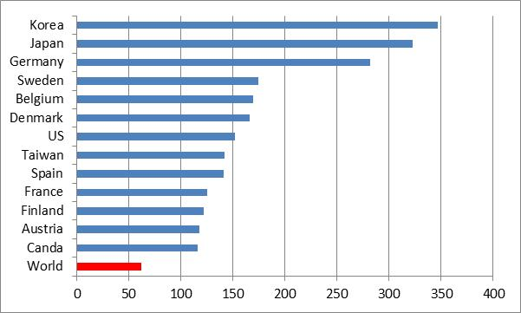
THE FUTURE IS ALREADY HERE….BUT NOT (YET) FOR ALL
Including software /licences the market value is three times higher
number of robots per 10 000 employees in manufacturing
THE DIGITALISATION OF MANUFACTURING IS REDEFINING THE ORGANISATION OF
PRODUCTION WITHIN AND BETWEEN FIRMS & the ORIGIN of RENTS
Source: OECD Development Centre based on IFR data

Slide 4
3 words to define the current landscape
UNCERTAINTY- COMPLEXITY- HIGH SPEED
Drivers of change
Science & Technology Aspirations & Values Global Challenges
YESTERDAY
TOMORROW
OUTPUT
PRODUCTS & SERVICES
EXPERIENCES
CORE VALUE
DESIGN & R&D
INTEGRATED SYSTEMS & PLATFROMS
COST-OPTIMISAITON DRIVEN
IMAGE&REPUTATION DRIVEN
VC ORGANISATION

Slide 5
In GOING FORWARD:
Higher speed (the windows of opportunities close up faster…)
Investment! Investment! Investment! The transition towards the new industrial & services model will require high(er) level of investments.
New and effective forms of public-private dialogue & partnerships
INTERNET CONNECTION SPEED
Higher heterogeneity
Growing divides
Risk of marginality
Growing concentration
More inclusive and sustainable economies
Tailor-made solutions (e.g. targeted medicine)
Stronger regional & globally connected production systems
Source: OECD Development Centre elaboration on Akamai Faster Forward State of the Internet Report, 2017

Slide 6
There is a growing need for strategic visions and coordinated policy actions to anticipate and shape the changes and to put “values-identity&citizens” at the core
Key areas for shaping the future
Skills for the future √
Infrastructure (ICT and physical) √
Standards &compatibility
Regulations on data storage, cybersecurity/privacy
IP and copyright including on data ownership
Redefining social contracts (responsibilities and rights)
Technology transfer
Digital trade
Regional integration and mulitilateralism

Slide 7

PTPRs- PRODUCTION TRANSFORMATION POLICY REVIEWS
A 5 pillar framework for effective governance and for successful production systems
ACTING
ADAPTING
ANTICIPATING
EMBEDDEDNESS
VALUES & IDENTITY
INTERCONNECTEDENESS
LEARNING
BEING

Slide 8
