Slide 1

Territorial policies for industrial renaissance and innovation
INTERNATIONAL CONFERENCE: Globalisation, human capital, regional growth and the 4th industrial revolution
M. Bellandi – University of Florence
Session on International Industry & Local Capabilities
Bologna 19th – 20th October 2017

Slide 2
The Italian manufacturing industry: from crisis
Up to 2007 (i.e. a pre- crisis period), the Italian manufacture has kept pace with its direct competitors (France, Germany, United Kingdom) in terms of export.
From 2008 to 2010 the Italian exports have plunged . In 2011 they have recovered the nominal euro values of 2007, and then have been growing healthy.
While, the Italian manufacturing employment was already declining in the pre-crisis period, and this decline has strongly accelerated in 2009. The decline has been particularly accentuated in the South of Italy.
However Italy in 2011 is still the second largest manufacturing economy of Europe, well behind Germany, but ahead of France and UK whose manufacturing industries have shrinkt more. It is 6th worldwide.
A specific trait of Italian manufacturing employment and Italian economy is still the role played by industrial districts (IDs) mainly specialized in ‘made in Italy’ sectors and SMEs (Becattini 2009). Business Census in 2011: a set of 141 IDs (out of 611 LMAs) (Istat 2015).
IDs have exposed different reactions before the Great Crisis and during it: not a homogenous tendency to decline, and still an important role for SMEs (Bellandi and Coltorti 2014)
…and even before the crisis the territorial systems led by large enterprises were not recovering a predominant presence!

Slide 3
to longer term transition and needs of rerouting
(scattered, explaining local cases of resilience)
Does not the shrinking of manufacturing jobs and activities imply automatically a reduced importance of manufacturing specializations, and by this a shrinking space for LPS as such, whatever their forms, in advanced economies?
Do servitization within manufacturing processes and other digital-based technologies (within the scope of Industry 4.0 or Smart manufacturing) reduce switching costs in the organization of different lines of production, enlarge the possibilities of automated personalisation within “smart” plants, increase the internal economies of scope realized by the single producers within and outside IDs, and lead therefore to a reduced importance of place-based external economies?
Even if solutions to the previous challenges exist and are consistent with a lease of life for new forms of LPS promoting industrial renaissance and innovation, does not the same nature of the new production processes make very difficult a wide rerouting of LPS to forms consistent with such solutions?

Slide 4
The big challenges of manufacturing areas
Increasing volatility and personalization of consumer demand in many markets (Lester & Piore, 2009);
opportunities and threats coming from new industrial countries with the international fragmentation of production (Humphrey & Schmitz, 2002);
disruptive introduction of new technologies in fields as ICT, AI, transport, materials, etc. (Duyin & Geissler, 2016)
enlarge the importance of synergies between specialized manufacturing industries and service activities, that are still difficult to be clearly understood because of the variety of their forms
MAKERS - Smart Manufacturing for EU growth and prosperity is a project funded by the Horizon 2020-MSCA- RISE - Grant agreement number 691192.

Slide 5
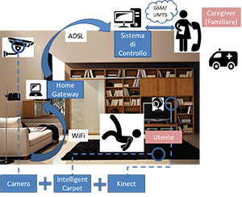
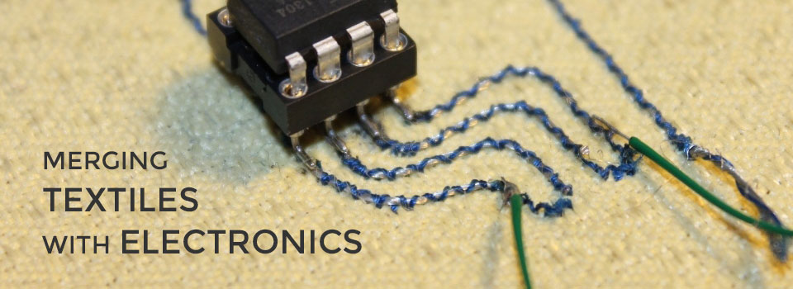
The big challenges
the value of Physical components is increasingly related to smart and connectivity components that speed and enlarge local and extra-local interactions (Porter and Heppelmann, 2014), between various actors, such as producers, customers and so on (see Cui & Wu, 2016).
FACTOTHUMS
A jacket that incorporates accelerometers, able to transmit the position of the worker.
FA.PRE PROJECT
Smart carpets placed on the floor allow a precise monitoring of the position of the person in the room.
MAKERS - Smart Manufacturing for EU growth and prosperity is a project funded by the Horizon 2020-MSCA- RISE - Grant agreement number 691192.

Slide 6


New generation of manufacturing goods
The introduction of business service activities in local systems of SMEs, for example in Italian IDs (Sforzi, 1994), is not a new phenomenon.
But the increasing importance of servitization nowadays: a significant impact on existing business models of manufacturing SMEs exposed to international competition (see Bettiol and Micelli, 2014)
Systems of SMEs are challenged and need enhanced capabilities. A TERRITORIAL response:
adaptation of the internal competences of the manufacturing SMEs → economies of specialization in old and new SMEs, (a) within a sectoral compact core of manufacturing know-how nuclei, or even (b) among a more polycentric core;
growth of nuclei of new KIS (knowledge intensive services) specific to the features of local SMEs, (a) pulled by the extent and the variety of the local demand, (b) helped by place-based policies, (c) connected with services provided by national and international actors/networks → new local and trans-local external economies
MAKERS - Smart Manufacturing for EU growth and prosperity is a project funded by the Horizon 2020-MSCA- RISE - Grant agreement number 691192.

Slide 7
From drivers of recovery in Italy after the long crisis
(scattered, explaining local cases of resilience)
Path-breaking SMEs within industrial districts adopting business models characterized by high intensity of qualified professionals and creative people; digital integration; cross-sectoral connectivity; and active role within international value chains
Medium to large firms involved in innovation partnerships with universities, local institutions and actors, regional and national institutions towards cultivation of emerging needs from cities and lands, cultural enhancement of products, etc.
Scientific and technological business parks and incubators, regional and national technological clusters and districts, co-working for social innovation, regulations favouring innovative start-ups and project financing
Cross-fertilization between new technologies and the structures and operations of utilities , local public services, health services, re-qualification of the building stock, and conservation of the architectural heritage

Slide 8
To perspectives for industrial policy
In “place-blind” interpretations of policies for the Italian industry (Barca et al., 2012) the territorial wealth of made in Italy is ignored
Its focus is on providing support to high-tech, high creativity, high finance functions localized in major cities -> IDs vs cities; SMEs vs Large firms
Those contrasts are misleading and prevent policy-makers from identifying actions to renew local sources, to reduce social and territorial divergence, and to upgrade the national position in the global scenario .
In other words to support the industrial revival:
IDs, cities, and other territorial systems should be considered as a fundamental structure of policies of industrial development in contemporary Italy.
This is consistent with the Place-sensitive distributed development policies (PSDDP) recently proposed by Iammarino, Rodriguez-Pose, Storper (2017)

Slide 9
Multi-scale and system industrial policies and strategies for the industrial revival
SYSTEM-BASED: for the construction of public goods specific to the development of production systems with an extended division of labor
MULTI – SCALE: The local level of the industrial economies and policies is fundamental but also dependent on processes which take place on larger territorial scales
The territorial scales: local, regional (including IDs, urban systems, etc.), national, international cross-cluster / trans-local collaborations
The organizational scales: not only including systems of SMEs and large firms, but also various networks built on skills, inter-business, internationalization and innovation opportunities

Slide 10
Strengthening and renewing local sources of development by means of support to:
the diffusion of open networking culture among SMEs; good practices in innovation funds and selection of industrial investment projects (also network projects); young entrepreneurs and innovative start-ups and academic spin-offs in new specializations as a basis for a larger variety of related sectors
creation of local partnerships with medium sized companies, universities and schools, public and private institutions and credit institutions on strategic planning for large investments in industrial research, new education curricula, smart land infrastructure; design of better training or placement activities
structures and capacities for international mobility and digital communication; connection to international cross-clusters / trans-local collaboration for IDs agents, through which a territory asserts its identity within wide cognitive networks and experiments novelties

Slide 11
Regional and national integrating policies and strategies
Processes integrating a disperse wealth of local resources in regional/ national wide innovation platforms would be necessary given the increasing openness and transversality of knowledge creation. Where and how in relation to Italian industry? Look to driving ideas on new ways of understanding life and work, as:
Culture, Science and High technology on/around Arts, Crafts and Food → high quality products and services for world markets and socio-cultural systems
Cities with dense cultural and landscape heritage → energy, mobility, building industries for sustainable World Heritage Cities and Countryside
Social Innovation and Local welfare → reducing costs, sustain quality and social cohesion, realizing new products and services for word markets
Green Investments and areas of large environmental crisis → huge money for restoration as large demand for innovative green products and services
Relations with ongoing policies, like the National Technological Clusters, the Regional Innovation Districts, the EU Cluster Excellence Initiative, etc.: University based units should be crucial actors in such networks.
However results accumulated in recent years on such actions are far from being evident, with exceptions in some regions….
11

Slide 12
Concluding..
Coming at the core of Becattini’s vision on the role of policies for local development: they should be both complex and light, that is reflecting a system-based view of trans-local and upper level relations, but also not pretending to shape deterministically the profound socio-economic dynamics of local development.
Giacomo Becattini’s inspiration: the decisive factor of resilience for local production and reproductive systems, such many industrial districts, is the confidence of their people, enterprises and institutions.
If able to preserve individually and collectively such self-confidence, they can constantly innovate and create faithfully to local evolving but authentic productive cores and social identities.-

