Slide 1
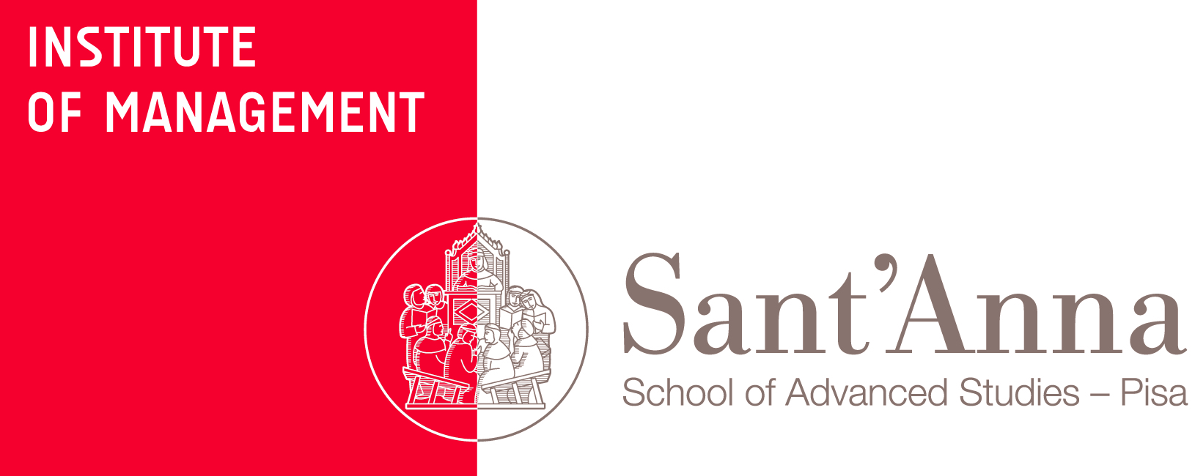
The soft infrastructure of the industrial revolution: why tourism matters
Nicola Bellini

Slide 2
This contribution
in facing the new industrial revolution, why tourism should matter
to practitioners
to scholars
to policy makers
shouldn’t we say something different from the past?

Slide 3
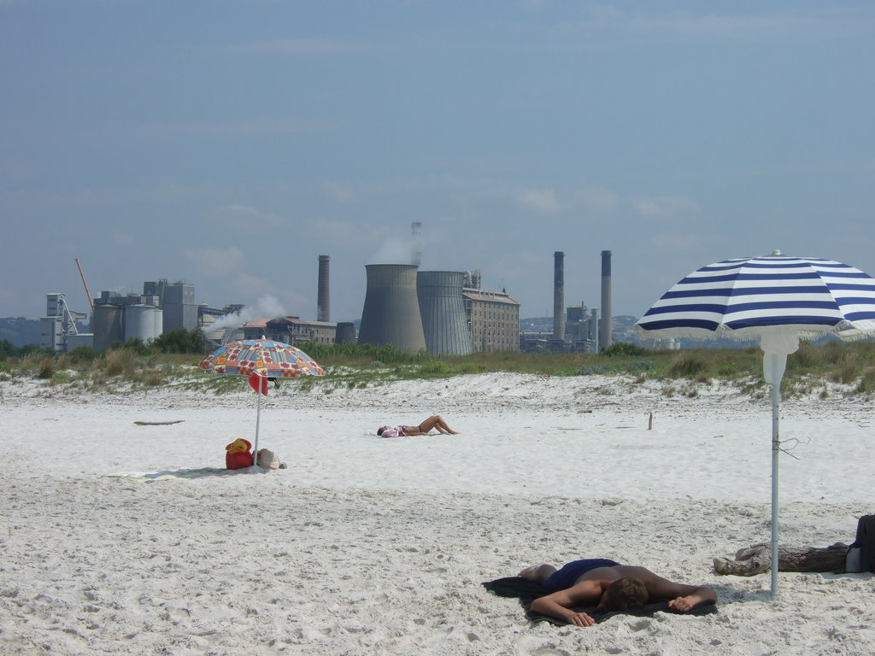
A history of conflict
Notes:
a history of conflict between the requirements of tourism and the requirements of manufacturing

Slide 4
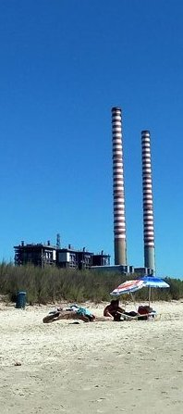
A history a misconceptions
Tourism-led development as an alternative
forgetting manufacturing? “too bad one sees the chimneys, but we will put a hedge” (Paolo Virzì, “La bella vita”, 1994)
Notes:
Tourism-led development as an alternative, both for developing countries and for deindustrializing regions

Slide 5
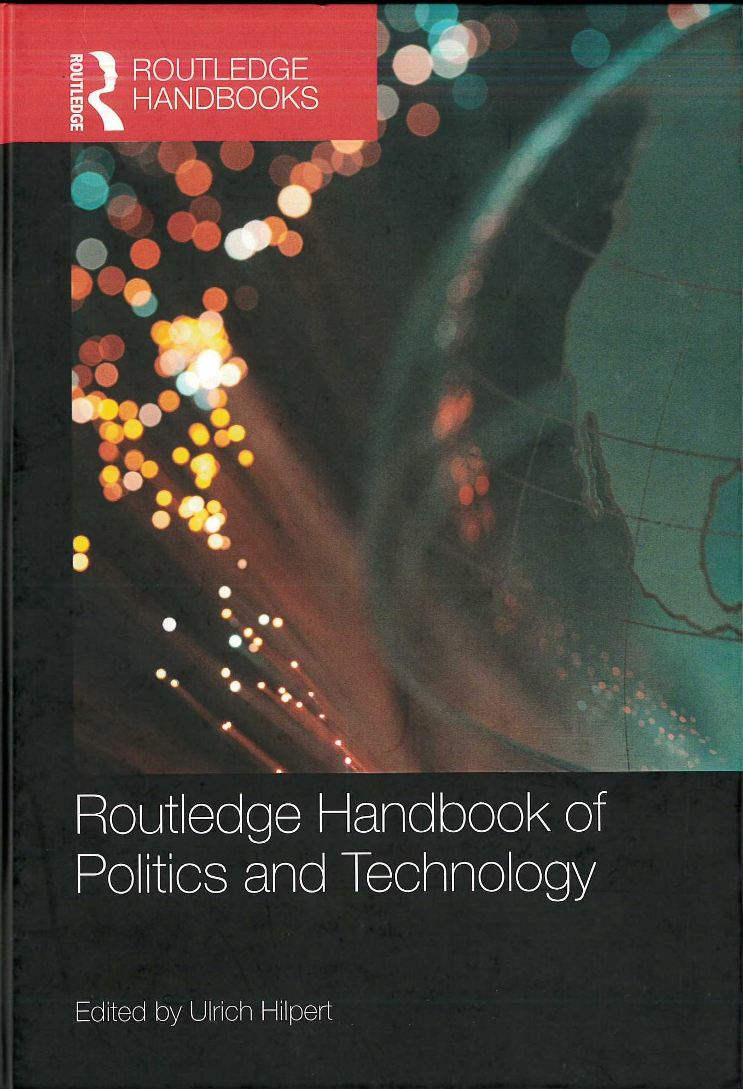
The “soft infrastructure”
A region’s soft infrastructure is the set of values, beliefs and attitudes that, narrated through the area´s cultural heritage and reflected into images and symbols, influence innovative decisions at individual and collective levels (Bellini & Pasquinelli, 2016)

Slide 6
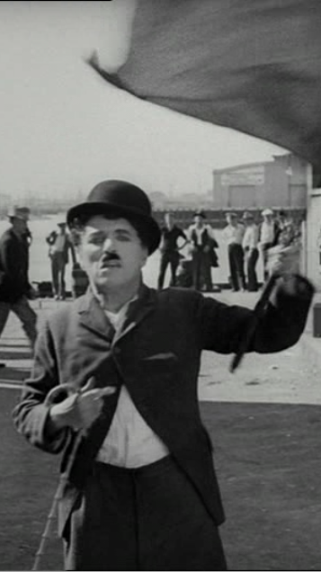
What is the “soft infrastructure” for Industry 4.0?
An underestimated issue?
limited awareness
generic but widespread fears: “robots steal our jobs”
often disconnected with heritage
socially sustainable?
Notes:
risultati della ricerca dell'Osservatorio Industria 4.0 della School of Management del Politecnico di Milano
su un campione di 241 imprese manifatturiere, solo l'8% dichiara di ignorare il tema (un anno fa era il 38%),
https://www.osservatori.net/it_it/osservatori/executive-briefing/industria-4.0-la-grande-occasione-per-l-italia
according to the Observatory on social capital DEMOS-COOP, in April 2017 50% of the Italians believe that new technologies destroy jobs. Of course those who are most scared are older , less educated, working-class or retired people (and housewives). And yet negative feelings are shown approximately by 48-51% of those between 24 and 54 years, 41% of those with higher levels of education, 43% of the white collars, 50% of the freelance professionals.
According to Eurobarometer. in 2012 the Netherlands were the least worried country about the impact of robots on jobs and yet 51% of the Dutch agreed with the statement that robots steel jobs.
In 2016, according to the British science association, 60% of the British people think that the use of robots or programs equipped with artificial intelligence will lead to fewer jobs within ten years

Slide 7
Tourism today
Not just a spectacular business growth
Tourism beyond leisure:
a key component of contemporary consumption behavior
a defining element of social status
a privileged context of learning (the “Grand Tour”)
Notes:
where the decisive experiences are made for personal and professional building (Bildung), shaping our vision of the world

Slide 8
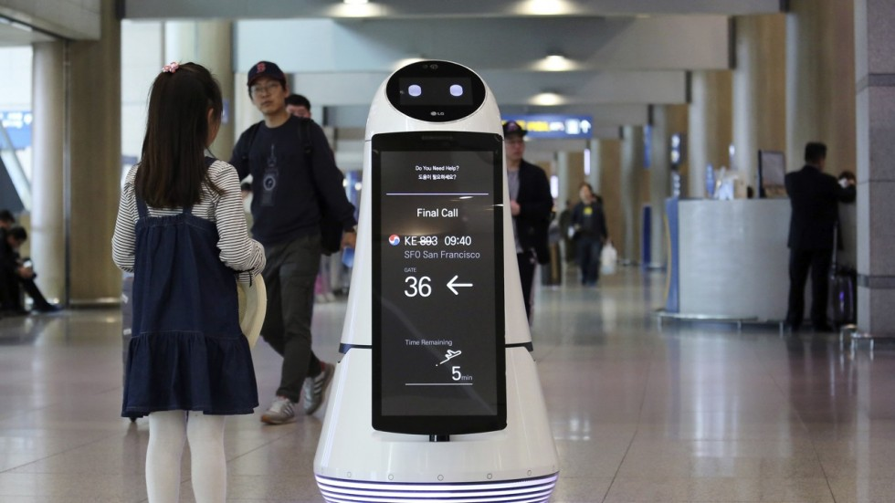
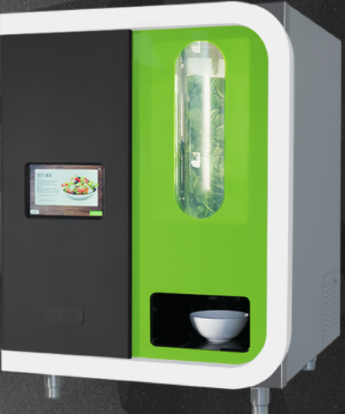
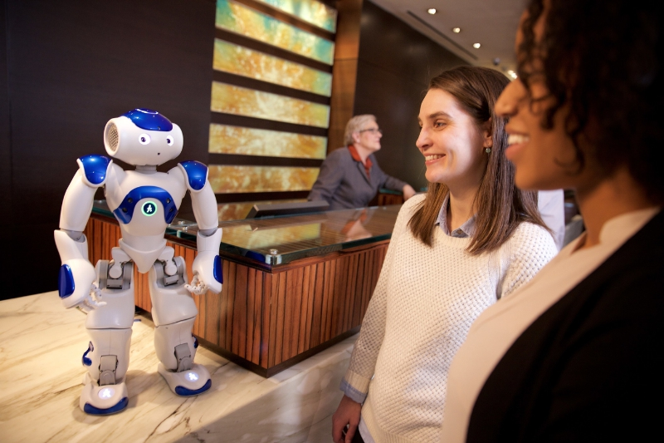
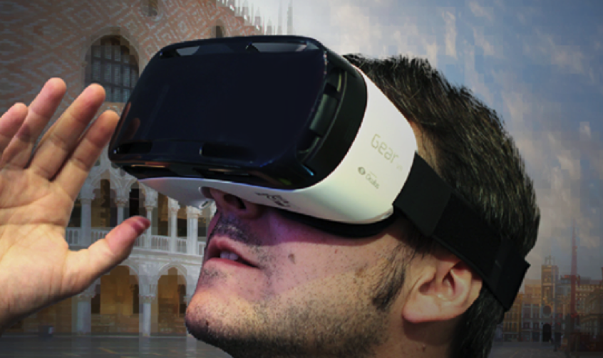
(1) Tourism as a context where innovation is increasingly experienced

Slide 9
(1) Tourism as a context where innovation is increasingly experienced
more than in any other industry:
tourism has witnessed Internet’s most radical, structural impact technological innovation has implied consumer empowerment
technology is not distant, but visible, close to personal experience, empathic
Notes:
empathic >> not closed behind the walls of the factory

Slide 10
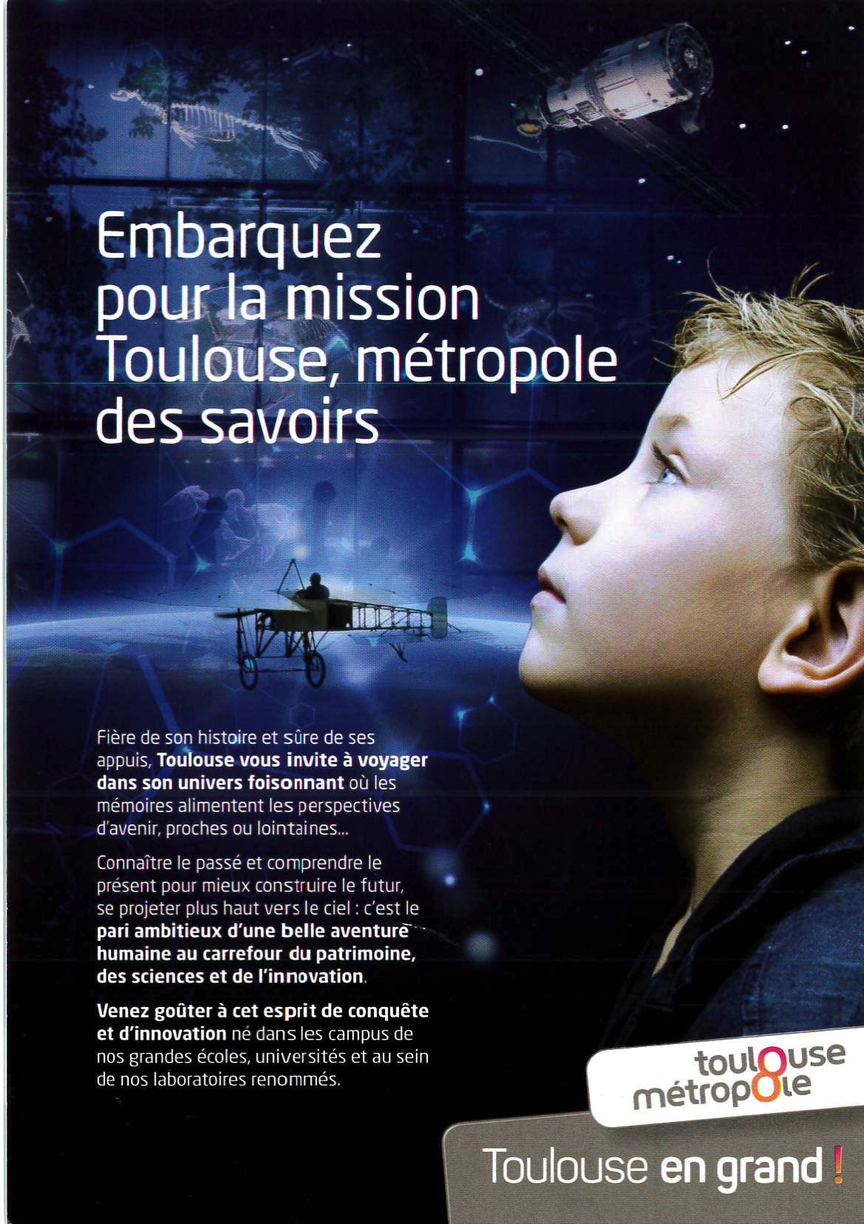
(2) Tourism as a context where one can learn about the future
e.g. the success of science and technology exhibitions vs. the obsession with backward-looking “cultural tourism”

Slide 11
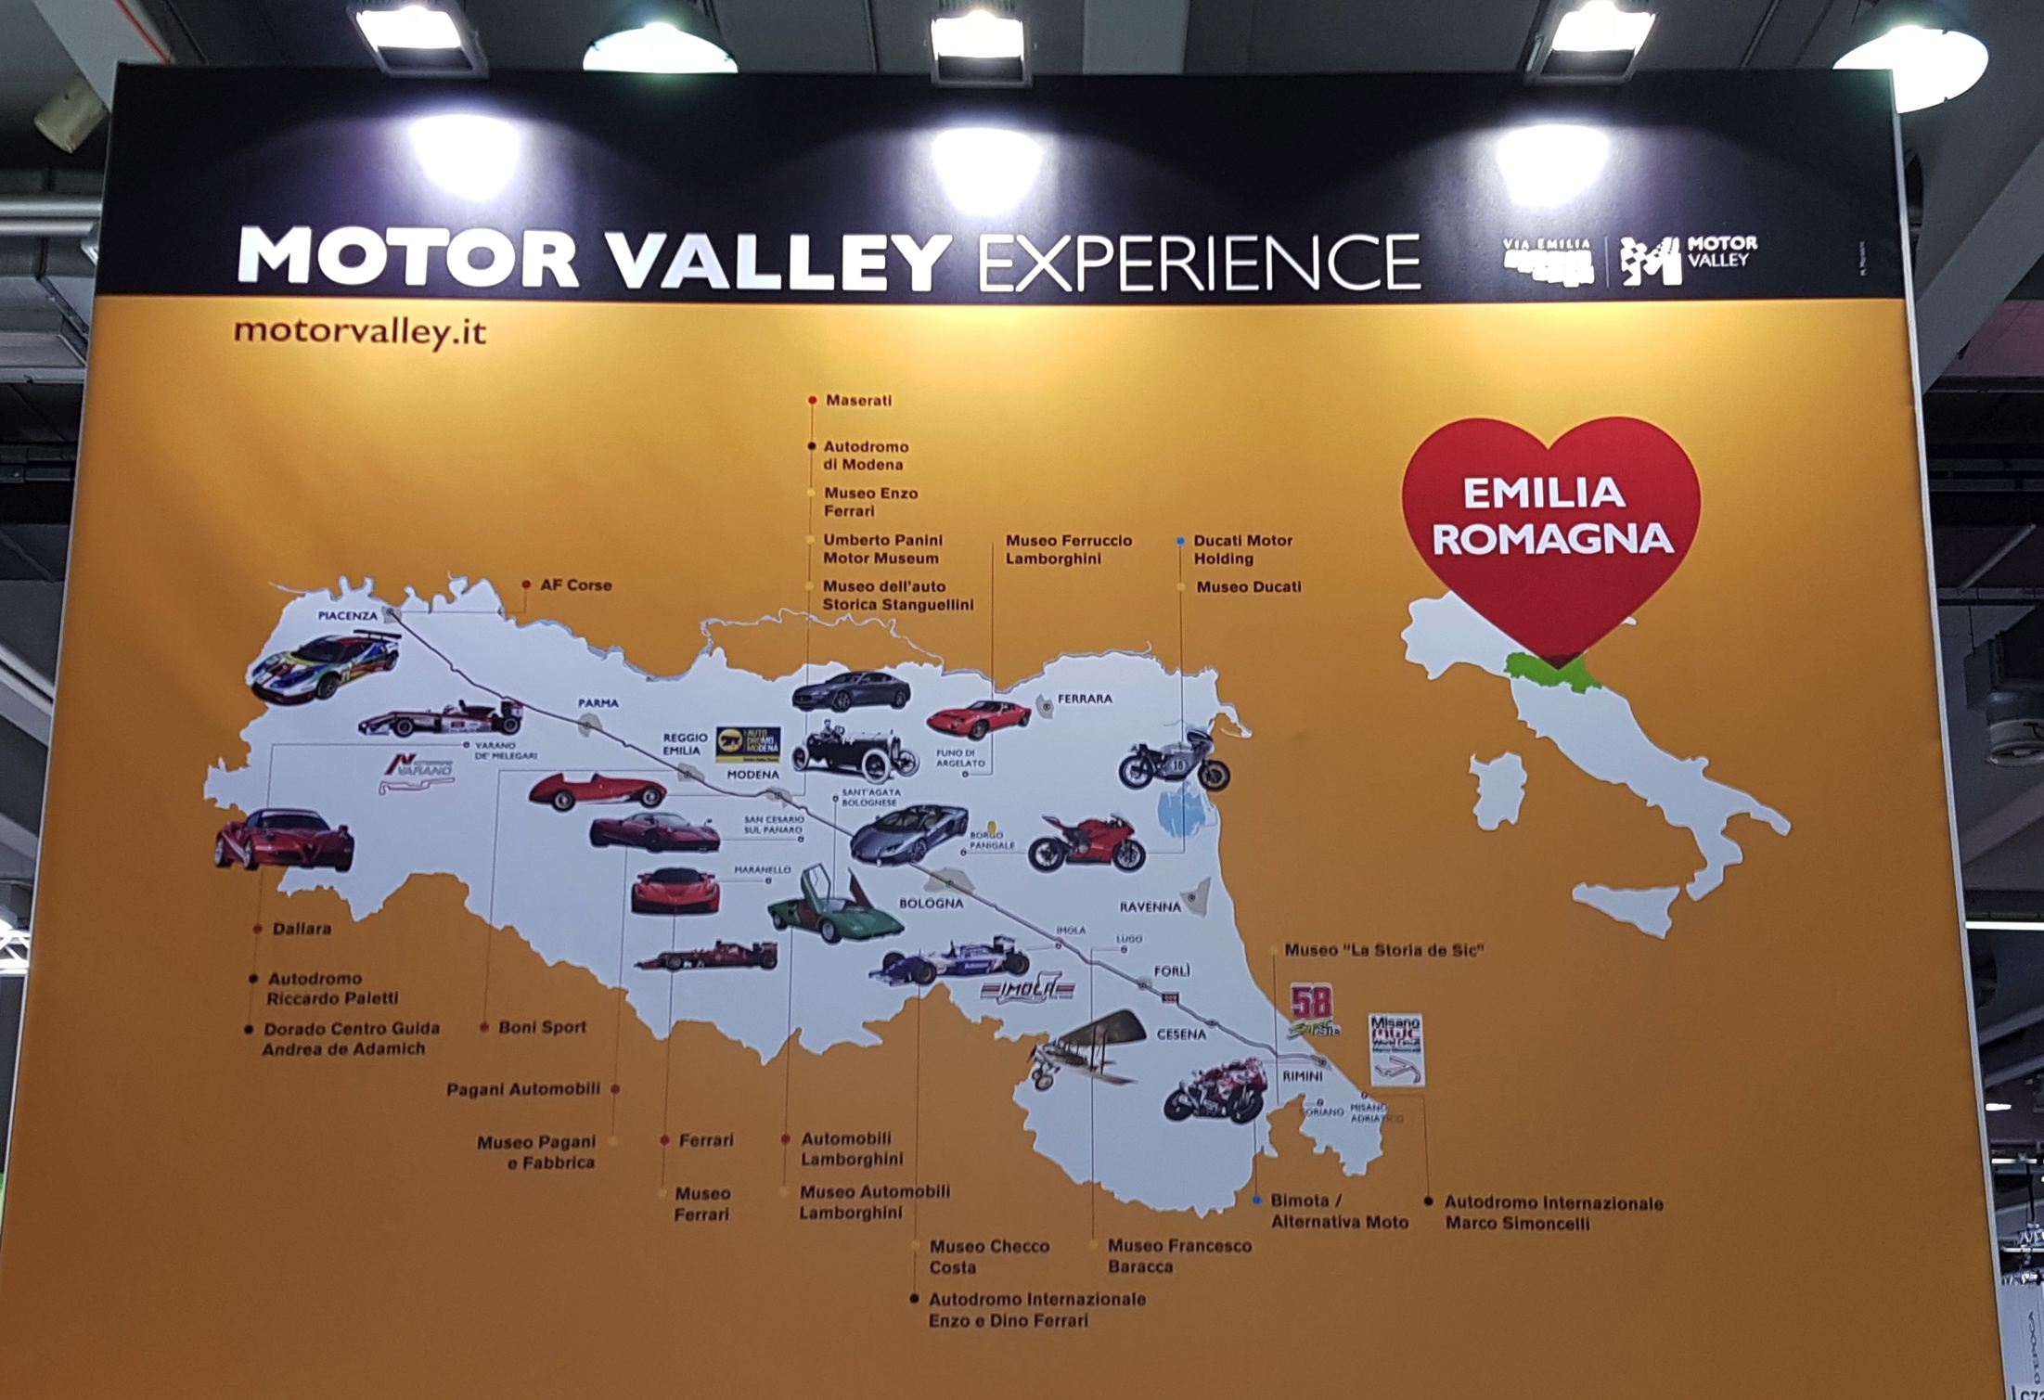
Notes:
worth a special appraisal – maybe some re-appraisal
http://www.motorvalley.it

Slide 12
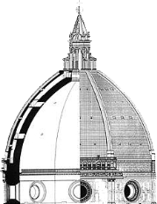
(2) Tourism as a context where one can learn about the future
Rethinking “pilgrimage tourism”: “Heritage is concerned with the ways in which very selective material artifacts, mythologies, memories and traditions become resources for the present” (Ashworth and Graham, 2005)

Slide 13
Taking tourism seriously
‘‘One learns more by traveling ten thousand miles than reading ten thousand books’’ (Ancient Chinese Saying)
Notes:
a quote for the knowledge-intensive regions

