Slide 1

Mediterranean Countries:
industry, trade and development
Salvatore Capasso
Istituto di Studi sulle Società del Mediterraneo – CNR
and
University of Naples Parthenope
Bologna 20 October 2017
GLOBALISATION, HUMAN CAPITAL, REGIONAL GROWTH and the 4TH INDUSTRIAL REVOLUTION

Slide 2
Objectives of the Talk
Provide a picture of the Area: Differences (reduced in the last decades) which can be translated into complementarities.
Describe the (asymmetric) effects of an external shock: the Financial crisis.
Focus on inequalities within countries which may reveal the real differences between countries: Social Expenditure and Labour markets.
Provide an example of how Economics, Demography and Politics jointly shape the future.

Slide 3
Outline
A broad picture
Macroeconomic Imbalances
Demographic Imbalances
Some facts about Migrations
Differences and Complementarities
Youth labour markets
Social Welfare
Arab Spring: an example of Economic, Political and Demografic mixture

Slide 4
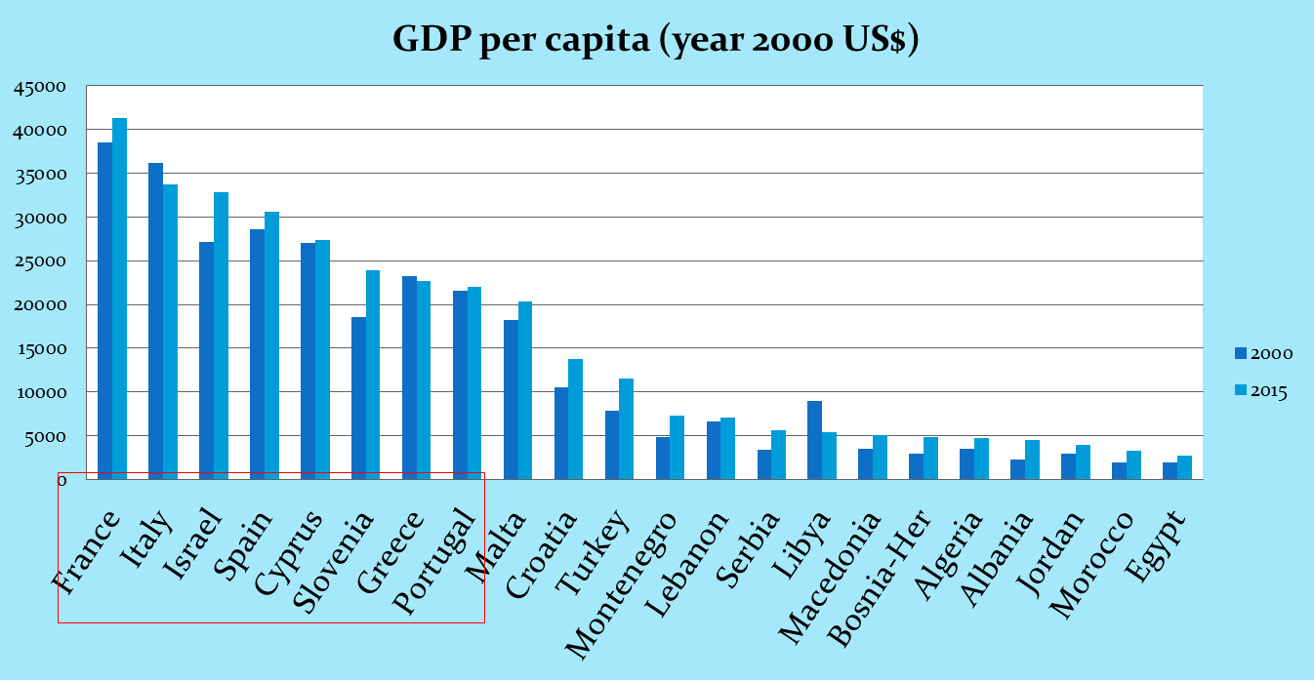
The Mediterranean: a frame of differences
Mediteranean Economies are far from being homogeneous.
Yet, there is a degree of homogeneity between areas: North, South and East.

Slide 5
The Mediterranean: a framework of differences
The financial crisis has not been symmetric: it caused recessions, stagnations or slower growth.

Slide 6
Convergence: inequality between countries
The last two decades have seen a convergence between Mediterranean countries. The cause: the lower growth rate in rich countires.

Slide 7
The distorsion in the Area
A mature low growth area faces a more dynamic, younger area
North M | France
 | Italy
 | Portugal
 | Spain
Est M | Albania
 | Bosnia
 | Croatia
 | Macedonia
 | Montenegro
 | Cyprus
 | Greece
 | Malta
 | Serbia
 | Slovenia
South M | Algeria
 | Morocco
 | Egypt
 | Syria
 | Turkey
 | Israel
 | Jordan
 | Lebanon
 | Libya

Slide 8
The future is crafted by the Demografy

Slide 9
Complementarities
Differences in resources endowments and in the sectoral compositions are possible sources of beneficial complementarities.

Slide 10
Urban systems
Urban systems add homogeneity to rather different economic systems

Slide 11
Migration push
Economics and Geography both influence migrations:
Differentials in per capita income (eg. 40.000$ in France against 8.000$ in Morocco)
Differential in the labour market flows ratio (incoming on outgoing flows, Ir) are relevant:
Europe: Ir = 83,01
Middle East: Ir = 234,34
North Africa: Ir = 249,65

Slide 12
The Migration Directions
Here some facts that dispel some stereotypes:
In the European countries the share of population born abroad does not exceed the average of 10%; it is between 30 and 40% in Middle Eastern countries (essentially refugee);
The total of regular migrant in UE countries in 2015 is 50 millions (10% of residents).
In 2008 the «irregular migrants» were between 1,9 e 3,8 millions.
The stock of irregular migrants is influenced by the number of regular migrants that become irregular.

Slide 13
Migrations in EU
The impact of migrations on Southern EU countries is more than double the impact of migrations on other EU countries
In 2015 the migrants living in southern EU countries were about 35,5 millions, of which one third (11,9) coming from other non EU mediterranean countries;
27,5 million are instead the migrants living in central-northern EU countries, of which less than 15% coming from mediterranean countries outside EU;
Eastern Mediterranean countries host 8 million migrants on a population of 40. In Lebanon and Giordan the number of migrants almost equate the residents.

Slide 14
Labour Markets
The crises has harshly hit EU Mediterranean countries

Slide 15
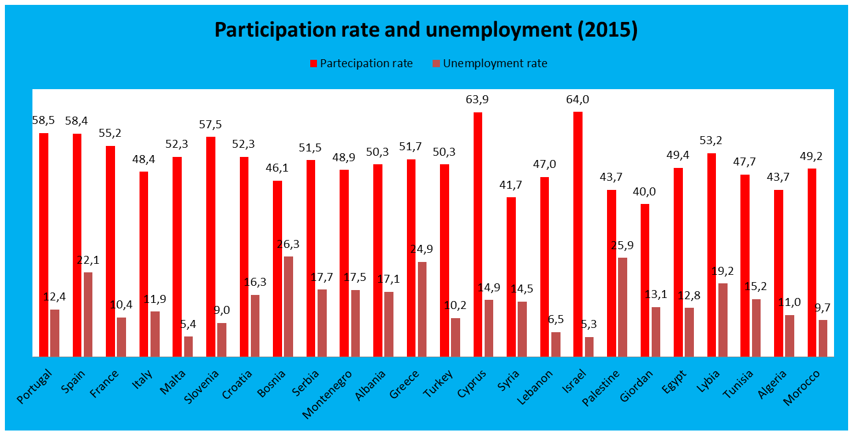
Labour Markets
Labour market appear to be rather homogeneous

Slide 16
Labour Markets
In many countries the issue is youth unemployment

Slide 17
The role of demography on labour market conditions
Decomposition in youth unemployment change (2000-2015)
 |  | Expansion |  |  |  | Recession
 | Rate of Growth | Rate of growth in downturn | Demographic effect | Cycle effect | Interaction effect | Rate of growth in downturn | Demographic effect | Cycle effect | Interaction effect
Portugal | -59,78% | -9,6% | -120,7% | 20,5% | 0,1% | -50,2% | -23,2% | -78,3% | 1,6%
Spain | -59,81% | 2,1% | -802,1% | 922,8% | -20,7% | -61,9% | -13,4% | -88,5% | 1,8%
France | -4,59% | 5,3% | -22,5% | 120,1% | 2,4% | -9,8% | -7,1% | -92,9% | -0,1%
Italy | -47,03% | -4,9% | -193,3% | 94,8% | -1,5% | -42,1% | -8,5% | -92,2% | 0,7%
Malta | -21,58% | -2,1% | -172,8% | 65,2% | 7,6% | -19,5% | -12,4% | -88,5% | 1,0%
Greece | -62,75% | -16,5% | -95,3% | -5,2% | 0,5% | -46,2% | -19,0% | -83,0% | 2,0%
Turkey | -5,72% | 9,9% | 23,1% | 76,6% | 0,3% | -15,6% | 10,9% | -110,3% | -0,6%
Israel | 6,66% | 14,9% | 88,3% | 11,7% | -0,1% | -8,2% | 7,4% | -106,7% | -0,7%
Palestine | 33,81% | 63,6% | 58,8% | 40,0% | 1,2% | -29,8% | 44,6% | -140,4% | -4,2%
Giordan | 4,50% | 8,7% | 368,7% | -261,8% | -6,9% | -4,2% | 25,1% | -123,8% | -1,2%
Egypt | 4,74% | 22,2% | 62,4% | 36,5% | 1,1% | -17,5% | -5,0% | -95,7% | 0,6%
Tunisia | -17,46% | -0,2% | -3137,7% | 3202,6% | -164,9% | -17,2% | -11,8% | -90,1% | 2,0%
Morocco | -25,05% | -18,3% | 4,7% | -104,8% | 0,1% | -6,8% | 13,2% | -111,7% | -1,5%

Slide 18
Social Mobility: inequality within countries
In the last decades inequality has decreased (Gini index): growth effect?
 | 1940-1969 | 1970-1979 | 1980-1989 | 1990-1999 | 2000-2006
Portugal | - | 40,10 | 35,70 | 35,90 | 37,16
Spain | 35,47 | 34,76 | 30,26 | 31,98 | 32,11
France | 49,73 | 37,37 | 34,91 | 29,30 | 27,60
Italy | 40,30 | 38,60 | 33,36 | 33,84 | 33,85
Slovenia | - | - | 21,88 | 25,99 | 26,07
Croazia | - | - | 26,10 | 29,19 | 29,68
Bosnia | - | - | - | 32,88 | 30,90
Serbia - Montenegro | - | - | - | 26,99 | 30,09
Macedonia | - | - | 32,22 | 31,17 | 32,56
Albania | - | - | - | 29,30 | 29,59
Greece | 42,99 | 41,68 | 36,33 | 34,65 | 33,27
Turckey | 54,13 | 48,94 | 46,76 | 45,66 | 43,60
Cyprus | 25,60 | - | - | 29,00 | 28,33
Israel | 31,51 | 36,55 | 39,56 | 38,92 | 38,05
Jordan | - | 39,08 | 36,58 | 40,68 | 38,84
Egypt | 37,45 | 35,80 | 35,50 | 37,72 | 36,11
Tunisia | 48,87 | 44,58 | 40,64 | 40,55 | 40,60
Algeria | - | - | 39,90 | 35,40 | -
Morocco | 52,40 | 56,75 | 40,97 | 37,51 | -

Slide 19
Social Expenditure: a large gap between areas
Social expenditure (% GDP) is very heterogenous in North and South Mediterranean countries. Social expenditure has not the aim of reducing inequalities.
 | 2003 | 2004 | 2005 | 2006 | 2007 | 2008 | 2009 | 2010 | 2011
Portugal | 25,1 | 25,7 | 26,6 | 26,2 | 25,6 | 26,2 | 29,1 | 29,1 | 28,4
Spain | 21,7 | 22,0 | 22,2 | 22,0 | 22,4 | 23,9 | 27,3 | 27,9 | 27,5
France | 33,0 | 33,0 | 33,1 | 32,9 | 32,6 | 33,0 | 35,4 | 35,6 | 35,6
Italy | 28,1 | 28,2 | 28,7 | 28,7 | 28,6 | 29,4 | 31,7 | 31,6 | 31,3
Malta | 21,5 | 22,5 | 22,1 | 22,4 | 21,8 | 22,5 | 23,8 | 23,9 | 23,8
Slovenia | 27,3 | 27,1 | 27,0 | 26,3 | 24,7 | 25,4 | 28,4 | 29,5 | 30,0
Greece | 22,4 | 22,2 | 23,5 | 23,9 | 25,1 | 26,9 | 28,9 | 28,8 | 29,6
Cyprus | 20,3 | 20,3 | 20,8 | 20,5 | 19,2 | 20,0 | 22,1 | 23,0 | 23,3
 | 2003 | 2004 | 2005 | 2006 | 2007 | 2008 | 2009 | 2010
Syria | - | - | 0,6 | - | 0,35 | 0,33 | 0,36
Lebanon | 4,8 | 4,3 | 4,5 | 5,1 | 4,38 | 4,59 | 4,26
Jordan | 0,8 | 0,6 | 13,0 | 9,7 | 10,53 | 5,72 | 6,61 | 5,46
Egypt | 7,1 | 7,6 | 7,8 | 14,8 | 12,5 | 14,57 | 13,58 | 11,13
Tunisia | 6,9 | 7,1 | 7,3 | 7,3 | 7,4 | 7,54 | 8,13 | 8,63
Algeria | 3,4 | 3,5 | 3,0 | -
Morocco | 4,0 | 3,7 | 3,3 | 3,6 | 3,82 | 3,99 | 3,76 | 3,79

Slide 20
Some final thoughts
Forces behind the dynamics of the Area:
Politics
Economy
Demography
=> It is difficult to establish which one prevails…
An example: The Arab Spring.

Slide 21
Arab spring: an economic fragility
Increasing needs…

Slide 22
Arab spring: an economic fragility
…and increasing costs have caused instability

Slide 23
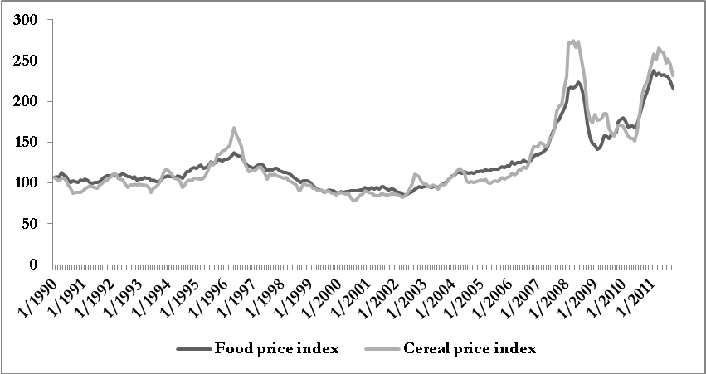
… and financials
Food price index and cereal price index (monthly data)

Slide 24
Thanks

