Slide 1
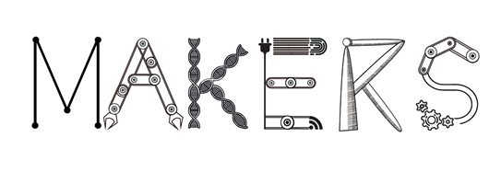
Disruptive Industry 4.0
Lisa De Propris
Professor of Regional Economic Development, Birmingham Business School
David Bailey
Professor of Industry, Aston Business School
Globalisation human capital regional growth and the 4th Industrial revolution, Bologna 20th October 2017
MAKERS - Smart Manufacturing for EU growth and prosperity is a project funded by the Horizon 2020-MSCA- RISE - Grant agreement number 691192.

Slide 2
Contents
Introduce MAKERS
Define I4.0
Present a broader interpretation
Policy shift: innovation matrix
The Swedish case
MAKERS - Smart Manufacturing for EU growth and prosperity is a project funded by the Horizon 2020-MSCA- RISE - Grant agreement number 691192.

Slide 3
What is MAKERS?
A network of business, academia and policy
In UK, France, Italy, Spain, Sweden, US, Singapore, Switzerland
With a research agenda and mobility
To study the drivers, enablers and dynamics of a new manufacturing model for Europe.
MAKERS - Smart Manufacturing for EU growth and prosperity is a project funded by the Horizon 2020-MSCA- RISE - Grant agreement number 691192.

Slide 4
WP1 Industry 4.0
WP8
Industrial Policy
WP2 Innovation & knowledge transfer
WP6
Sustainabilty
WP7
Skills
WP 3
SMEs and LPSs
WP4 Reshoring
WP5
Glocal value chains
MAKERS - Smart Manufacturing for EU growth and prosperity is a project funded by the Horizon 2020-MSCA- RISE - Grant agreement number 691192.

Slide 5
Technological change
MAKERS - Smart Manufacturing for EU growth and prosperity is a project funded by the Horizon 2020-MSCA- RISE - Grant agreement number 691192.

Slide 6
Kondratiev’s Long Waves
Steam Cotton Iron
Railways
Iron
Steel
Electricity Chemicals
Autos
Electronics
Synthetics Petrochemicals
now
Indices of economic activity
K1 K2 K3 K4 K5
1800 1850 1900 1950 2000s
MAKERS - Smart Manufacturing for EU growth and prosperity is a project funded by the Horizon 2020-MSCA- RISE - Grant agreement number 691192.

Slide 7
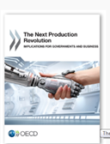
Revolution or evolution?
MAKERS - Smart Manufacturing for EU growth and prosperity is a project funded by the Horizon 2020-MSCA- RISE - Grant agreement number 691192.

Slide 8
4th Industrial revolution
Biotech, nanotech, neurotech, green & renewables, ICT & mobile tech, 3D, AI, Robotics, sensoring & space tech, drones
MAKERS - Smart Manufacturing for EU growth and prosperity is a project funded by the Horizon 2020-MSCA- RISE - Grant agreement number 691192.
Notes:
Cyber-physical systems
Increased velocity through the Research-Development-Innovation pipeline

Slide 9
EU def of Industry 4.0
AI- IoT – robotics- automation
Cyber-physical systems (smart ordering, scheduling, control and delivery systems, ‘big data’.
New combination capital & labour
lower inventory upstream, in process and downstream.
Max productivity
Efficiency driven arguments→
Smart and webbed factories
Large plants
Large firms or multi-national firms
Mass customisation
MAKERS - Smart Manufacturing for EU growth and prosperity is a project funded by the Horizon 2020-MSCA- RISE - Grant agreement number 691192.

Slide 10
In MAKERS → Broader
Biotech, nanotech, neurotech, green & renewables, ICT & mobile tech, 3D, AI, Robotics, sensoring & space tech, drones
1) New technological capabilities
4) New sectors
5) New forms of B2B linkages
2) New cyber-physical system
2) New organisation of production inside factory – smart factory
3) Makers, innovators
MAKERS - Smart Manufacturing for EU growth and prosperity is a project funded by the Horizon 2020-MSCA- RISE - Grant agreement number 691192.
Notes:
Cyber-physical systems
Increased velocity through the Research-Development-Innovation pipeline

Slide 11
Industry 4.0
I4.0
New markets
Personalised flexible
Artisan customisation
New business models
(gig economy & Servinomics)
Sustainability core
New production spaces
(Connected factory)
New technologies
Local supply chains
MAKERS - Smart Manufacturing for EU growth and prosperity is a project funded by the Horizon 2020-MSCA- RISE - Grant agreement number 691192.
Notes:
When we think about manuf we think about China, cheap standardised, goods filling up containers across continents.
That manuf is underpinned by an old technology paradigm. It symbolises the end of a technology paradigm where competition was fundamentally about costs and prices.
Servitisation = Pay by use

Slide 12
Key issues
Co-creation
New ways of consuming, using, accessing or free-riding
Servitising consumption and sourcing
Downscaling
Rethink products and processes from an ecological perspective

Slide 13
Berger 2014- Industry 4.0
Industrial excellence
production process sophistication
Degree of automation
Workforce readiness
Innovation intensity
Value network
VA
Industry openness
Innovation network
Internet sophistication
Berger 2014
MAKERS - Smart Manufacturing for EU growth and prosperity is a project funded by the Horizon 2020-MSCA- RISE - Grant agreement number 691192.

Slide 14
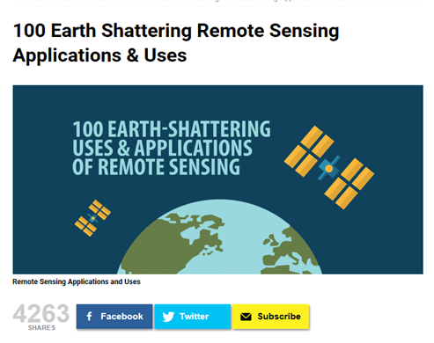
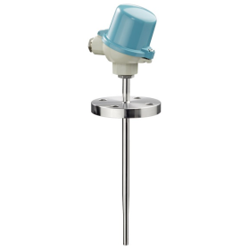
Take one technology: remote sensoring
Cloud
agriculture
machinery
Medical devices
Home
transport
IoT
MAKERS - Smart Manufacturing for EU growth and prosperity is a project funded by the Horizon 2020-MSCA- RISE - Grant agreement number 691192.
Notes:
Determining soil moisture content using active and passive sensors from space
10. Detecting oil spills for marine life and environmental preservation
38. Keeping tabs on the shift from rural to urban growth
46. Driving with no hands (autonomous vehicles)
GPS use for areal observation

Slide 15
Enable disrupting change
Regional level
National level

Slide 16
Innovation matrix
National scale
Vision target
Sustainability
Institutional framework- key actors
Technology
Key new(enabling) technologies
Regional innovation system
Triple helix
Sector
IDs, clusters,
industrial commons

Slide 17
Innovation matrix
National scale
Vision target
Sustainability
Institutional framework- key actors
Technology
Key new technologies
Regional innovation system
Triple helix
Regional sector
Historical sectors,
industrial commons
External economies
Trust

Slide 18
Policy infrastructure
MAKERS - Smart Manufacturing for EU growth and prosperity is a project funded by the Horizon 2020-MSCA- RISE - Grant agreement number 691192.

Slide 19
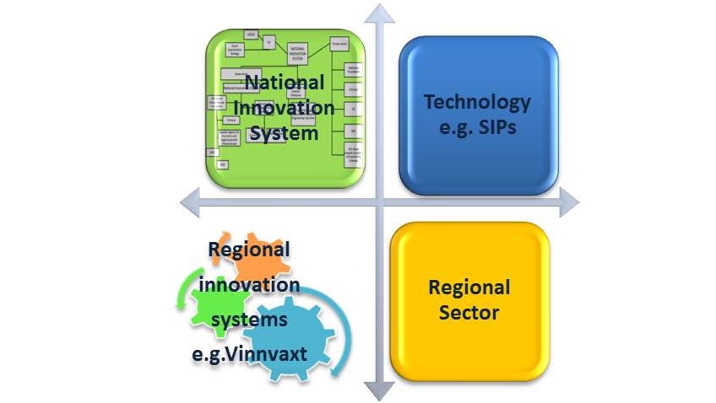
Innovation matrix in Sweden
MAKERS - Smart Manufacturing for EU growth and prosperity is a project funded by the Horizon 2020-MSCA- RISE - Grant agreement number 691192.

Slide 20
Swedish NIS
Government
Ministry of Enterprise and Innovation
Ministry of Education and Research
Vinnova
Swedish Agency for Economic and regional growth (Tillväxtverket)
Universities
Swedish Research Council
RI.SE
ALMI
H2020
Smart specialisation Strategy
Business sector
Large MNEs e.g. ABB, GE
EU
Confederation of Swedish Enterpries
E.G Teknikföretagen- Association of Swedish Engineering Industries
National Innovation Council
Ministry of Labour
NATIONAL INNOVATION SYSTEM
YH
SWerea
IVA- Royal Swedish Academy of Engineering Sciences
Wallanberg Foundation
WASP
SMEs
Företarga
Univesiry Colleges
Industrifonden
MAKERS - Smart Manufacturing for EU growth and prosperity is a project funded by the Horizon 2020-MSCA- RISE - Grant agreement number 691192.

Slide 21
Policy infrastructure in Sweden
MAKERS - Smart Manufacturing for EU growth and prosperity is a project funded by the Horizon 2020-MSCA- RISE - Grant agreement number 691192.

Slide 22
In Sweden…
BIO-PLATFORM
Innovation System Vinnväxt:
BoF, PP, ST
DIGITAL PLATFORM
I4.0:
IoT
SIP: IoT
ROBOTICS PLATFORM
I4.0: Biotech, nanotech, neurotech, green & renewables
SIP: BioInnovation
Innovation system
Kista Science City
I4.0: robotics, mobile tech, 3D, AI, autonomous vehicles
SIP: PiiA, P2030
Innovation System
Vinnväxt:
Process IT, Robotdalen & AutomationRegion
Technology strategy at the national level
RIS linked to sectors

Slide 23
Pinch points for change
Lack of information
Vested interests
Resistance to change
Risk and uncertainty
Delusion about the inevitable supremacy of services
Belief that businesses & market know better
MAKERS - Smart Manufacturing for EU growth and prosperity is a project funded by the Horizon 2020-MSCA- RISE - Grant agreement number 691192.

Slide 24
Implications for industrial policy
Political understanding of scale of change → information and education
Design clear and communicated vision → shared vision
Promote technology adoption and application→ join tech with sectors
Join national with regional scales →multi-level
→ Industrial policy
MAKERS - Smart Manufacturing for EU growth and prosperity is a project funded by the Horizon 2020-MSCA- RISE - Grant agreement number 691192.

Slide 25
Firms’ Readiness to I4.0
Interview and firm survey
awareness
applicability
adoption
advantage
Sweden
Bio-based sectors
Digital
Italy
nautical
Robotics
Germany
engineering
UK
auto
ICT
Drivers, barriers, conditions and needs of small and large firms
to adopt the I4.0 model.
MAKERS - Smart Manufacturing for EU growth and prosperity is a project funded by the Horizon 2020-MSCA- RISE - Grant agreement number 691192.

Slide 26
Ready? Why and How?
Learners
Adopters
Shapers
Laggards
MAKERS - Smart Manufacturing for EU growth and prosperity is a project funded by the Horizon 2020-MSCA- RISE - Grant agreement number 691192.

Slide 27
Thank you
l.depropris@bham.ac.uk
d.bailey@aston.ac.uk
www.makers-rise.org
Q&A
MAKERS - Smart Manufacturing for EU growth and prosperity is a project funded by the Horizon 2020-MSCA- RISE - Grant agreement number 691192.

