Slide 1
Varieties of the National Innovation Systems and Readiness for the 4th Ind. Revolution:
Korea and 4 European Economies
Keun Lee
(www.keunlee.com)
** Professor of Economics, Seoul National University
Editor, Research Policy
Council Member, World Econ. Forum
President, Int’l Schumpeter Society
Member, Committee for Development Policy, UN-ECOSOC

Slide 2
Variety of Innovation systems (IS):
A Schumpeterian Concept
National Innovation Systems = NIS
Sectoral = Sectoral SI (SSI)
firm = Corporate IS (CIS)

Slide 3
Lundvall (1992): NIS (national Innovation system) = elements and relationships 1) which interact in the production, diffusion and use of knowledge 2) rooted inside the borders of a nation state. -> Differences in NIS determines competitiveness of nations, sectors and firms. => System failure cf) market failure

Slide 4
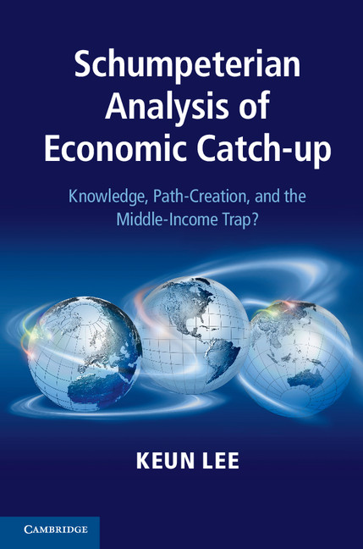
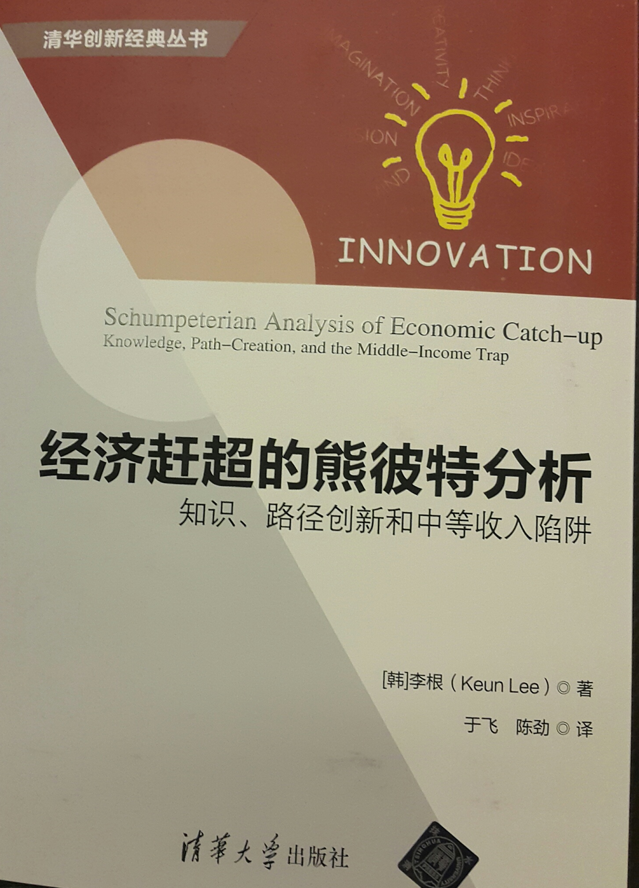
Innovation systems at 3 Levels: country; Sector; firm
=> 2014 Schumpeter Prize

Slide 5
5 Key Variables of NIS and Readiness for 4th IR (Lee 2013)
Intra-national creation and diffusion of Knowledge = localization of knowledge (vs. reliance on foreign sources)
Balanced vs. Concentration of knowledge creation (by assignees)
Short vs. long cycle technologies
High vs. low originality technologies => 4IR
Technological Diversification -> 4IR (Wide vs. Deep in patent portfolio)
DB free to download: www.keunlee.com:
For every country: 1975-2005

Slide 6
Regressing growth onto NIS variables: Asian 4 as benchmark
 | Asian 4 | High Income | middle Inc. | World
Tech cycle time | (-)* | (+)* | (+)* | (+)*
Localization of knowledge | + | (+)* | + | (+)*
Originality | + | + | + | +
HH: inventor concentration | (-)* | (-)* | (-)* | (-)*
Asian 4 Dummy |  | (+)* | (+)* | (+) *
Controls: Initial income, Population, Investment, secondary enrollment
Economic growth = long cycle, knowledge creation, balanced innovation
cf) Shorter cycle leading to catch-up growth in Asian 4

Slide 7
A Key Variable in Korea’s catch-up = cycle time of technologies
Cycle time = speed of change in the knowledge base of a technology
= mean citation lag
= time difference between the application year of the citing patent
and of the cited patents
“To catch up, specialize in Short cycle technology-based sectors“
because old knowledge quickly obsolete/useless
+ new knowledge tend to emerge more often
-> less disadvantageous for the latecomers
=> technological sectors
with less reliance on the old technologies
but with greater opportunity
for emergence of new technologies

Slide 9
Top 10 Classes of G5 vs Korea-Taiwan ->no overlap
G5 | Class | Class Name | Patent count
1 | 514 | Drug, Bio-Affecting and Body Treating Compositions | 10349
2 | 428 | Stock Material or Miscellaneous Articles | 3883
3 | 73 | Measuring and Testing | 3789
4 | 123 | Internal-Combustion Engines | 3479
5 | 424 | Drug, Bio-Affecting and Body Treating Compositions | 3389
6 | 210 | Liquid Purification or Separation | 2853
7 | 435 | Chemistry: Molecular Biology and Microbiology | 2852
8 | 250 | Radiant Energy | 2639
9 | 264 | Plastic & Nonmetallic Article Shaping or Treating | 2349
10 | 324 | Electricity: Measuring and Testing | 2325
Korea-Taiwan | Class | Class Name | Patent count
1 | 438 | Semiconductor Device Manufacturing: Process | 1189
2 | 348 | Television | 712
3 | 439 | Electrical Connectors | 408
4 | 257 | Active Solid-State Devices ( Transistors, Solid-State Diodes) | 374
5 | 362 | Illumination | 374
6 | 280 | Land Vehicles | 355
7 | 365 | Static Information Storage and Retrieval | 346
8 | 70 | Locks | 340
9 | 360 | Dynamic Magnetic Information Storage or Retrieval | 313
10 | 482 | Exercise Devices | 311

Slide 10
Korean in the Post-Catch-up = 2 Turning Points
1st in the mid 80s: to short cycle sectors
2nd in the 2000s: to long cycle sectors; ex. Samsung
2 Tech. turning point

Slide 11
NIS (national Innovation systems)
in
Korea, Italy, Germany, France and UK

Slide 12
Italy = longest Cycle time (machineries) = good for profitability
Korea = shortest cycle time = vehicle for late entry and catch-up

Slide 13
UK = lowest localization = highest internationalization
Germany = high; Korean rapid catch-up

Slide 14
Concentration of Innovation in Korea vs. Balanced in Europe

Slide 15
Germany = most diversified;
Italy = least diversified (ready for 4IR?)

Slide 16
Originality (readiness for 4IR):
UK, Germany highest; Korea lowest:

Slide 17
Summary of NIS by countries
Italy: longest cycle time-based technologies (good for profit & growth)
but low degree of tech. diversification, lower degree of knowledge localization, and medium level of originality
2) UK: highest originality and longer cycle tech
but less diversified; lowest intra-national diffusion.
-> maybe, better to try to increase intra-national diffusion (which is lower than Korea); a bit more diversification.
Germany: highest diversification and highest localization
relatively high originality and medium cycle time
4) Korea: highest localization and concentration
= nationalistic and big business led NIS
has still yet to catch up in terms of longer cycle tech, diversification,
less concentration (too much by Samsung; too Few by SMEs);
5) France = Always in the middle; no clear-cut distinction

Slide 18
Another measure of NIS
And Readiness for 4th IR
= degree of having more or less of
fusion / convergence technologies
(patent classified into multiple classes/categories;
their share in total %)

Slide 19
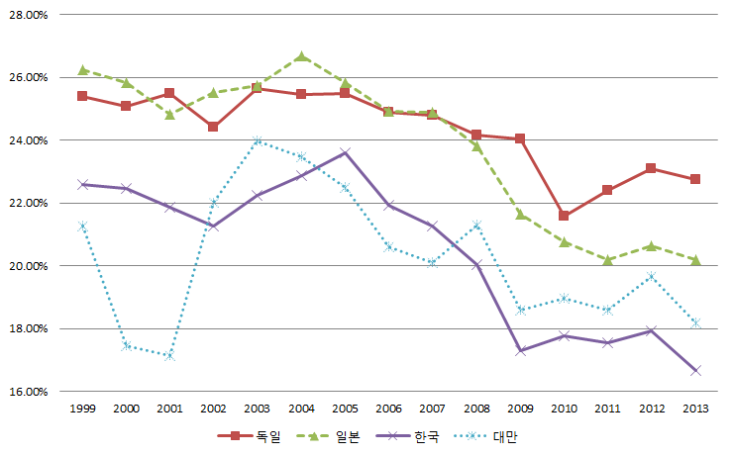
Average degree of Fusion technologies (%) :
Korea , Japan, Taiwan and Germany
Germany
Japan
Korea

Slide 20
Number of Patents corresponding to Fusion technologies :
Korea , Japan, Taiwan and Germany
Years | Germany | Japan | Korea | Taiwan
1999 | 2,056 | 8,123 | 787 | 446
2000 | 2,270 | 8,039 | 715 | 536
2001 | 2,574 | 8,249 | 737 | 626
2002 | 2,474 | 8,898 | 762 | 810
2003 | 2,664 | 9,136 | 830 | 885
2004 | 2,533 | 9,437 | 982 | 1,048
2005 | 2,128 | 7,815 | 991 | 892
2006 | 2,293 | 9,283 | 1,260 | 1,085
2007 | 2,052 | 8,419 | 1,323 | 1,055
2008 | 1,986 | 8,120 | 1,509 | 1,265
2009 | 1,979 | 7,776 | 1,517 | 1,217
2010 | 2,452 | 9,424 | 2,076 | 1,578
2011 | 2,462 | 9,456 | 2,159 | 1,675
2012 | 2,918 | 10,664 | 2,370 | 2,139
2013 | 3,175 | 10,711 | 2,420 | 2,084

Slide 21
Summary and Readiness for 4th IR
1) Korea
short cycle-tech & Big business based catch-up mode of NIS;
-- low readiness for 4th IR
(lowest originality; medium diversification; lower fusion)
2) Italy = long cycle tech. and Medium sized firm based NIS ;
good basis for profitable growth; but lower readiness for 4th IR
(low originality and lowest diversification)
3) Germany = best ready for 4th IR
(highest diversification; high originality and fusion)
4) UK = ready for 4IR with highest originality
but needs to be more diversified

Slide 22
From the GVC (Gloval Value Chain) to Innovation Systems for Local Value Chains and Knowledge
Just accepted for European J of Development Research
Keun Lee (www.keunlee.com)
(with Z. Mao and M. Szapior)
Seoul National University; Editor, Reserach Policy
A Member, CDP (committee for Dev’t Policy, UN/DESA)

Slide 23
Trend of GVC participation in Korea: Measured by FVA = share of foreign value-added in gross exports ->Increasing share of domestic V-add in exports, 1980 -1993
Hummels, Ishil and Yi (2001)
OECD entry

Slide 24
Intra-national Citation in Patents (~self-citation)

Slide 25
Thank you!
ありがとう!
Gracias!
Meu Amigo! Obrigado!
謝謝大家
Danke Shon
감사합니다

