Slide 1
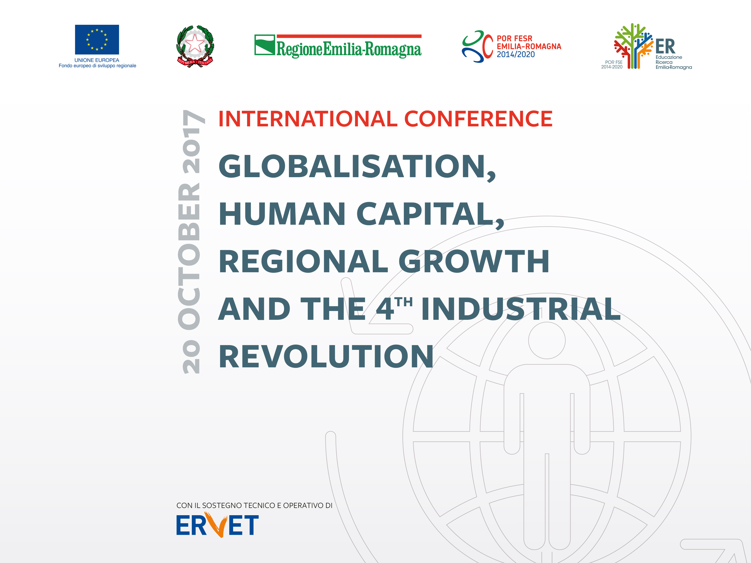

Slide 2

Long-term challenges of industrial development in Latin America and the Caribbean
.
Is there a successful contemporary development experience that has not been based on the manufacturing sector and has not been driven by deliberate policies?
Jorge Máttar
Bologna, Italy, 19-20 Octobre 2017

Slide 3
Contents
Policy and industrial development in Latin America and the Caribbean: one model, three styles
Outlook and perspectives - industrial development requires thinking and acting for the long term
Challenges for industry and development policies: progressive structural change
Considerations on an industrial policy to meet the challenge of structural change

Slide 4
1. Policy and long term industrial development in LAC: one model, three styles…
South America – commodities, manufacturing based on natural resources with little industrial transformation, trade focuses in Asia and Europe;
Northern Region of LAC - basic manufacturing, “maquila”, USA main trade partner and investor;
Caribbean, financial services and tourism
Regional integration - weak trade & investment linkages within the region

Slide 5
…and similar results for the whole region
Structural heterogeneity: productivity, competitiveness, wages, territorial (between and within countries)
Slow incorporation of technical progress: low effort in STI => few new knowledge-intensive dynamic activities
Non-competitive and vulnerable international insertion
Scheme conducts to economic concentration (income and territorial), regional disparities and social inequality
Structural problems persist and new challenges arise, such as the impact of robotisation on employment

Slide 6
Productivity is lagging within the region and with respect to world

Slide 7
Insufficient technological effort
Notes:
Patentes y X de bienes de tec alta y media

Slide 8
Notes:
Diversificación y grado de softsticación de productos exportados

Slide 9
2. Industrial development requires thinking and acting for the long term
(regardless of the model or style of development that follows LAC)
Sustainable and inclusive development requires long-term strategic design (industrial policy)
Complex int´l scenario and 2030 Agenda for SD => great opportunity to explore alternatives to the path and style of dev´ment and engines of growth followed by the region =>
Structural transformations, crucial to a) raise investment; b) systematically and permanently raise productivity; (c) revitalize regional integration & cooperation.
Strategic thinking and political will are crucial

Slide 10
3. Present and future challenges for LAC industrial development
LAC industrial challenges depend largely on past trajectories, development model objectives and policy/instruments mix
Historical opportunity: “The future we want” for LAC: Earth Summit Rio +20, 2030 Agenda: prosperity, justice, inclusion, sustainability and equity
Development results of deliberate actions agreed upon by Society, State and Market, explicitly or implicitly, with democratic, participatory dialogue…
Is this possible?

Slide 11
Industrial policy? In LAC? Really?
Intervention of the state to stimulate economic activities and promote structural change.
Dynamic process which pursues certain objectives based on national development priorities
Policies and Instruments: commercial; SME; STI; sectoral and territorial; education and training; competition and competitiveness
Ok, We may accept Industrial Policy, but for what?, which are the challenges to address?

Slide 12
3. Progressive structural change: the major challenge?
Washington consensus exhausted…
Progressive Structural Change (PSCh):
  Change in product composition towards dynamic-high productivity activities, incorporating technical progress
  Increase productivity in existing activities
  Reduce territorial disparities
PSCh brings about higher long-term economic growth and better-paid jobs – a new path to inclusive development and reduced inequality and poverty

Slide 13
Income disparities at the territorial level
Fuente: CEPAL 2014 en base a información oficial de los países.
Notes:
Información a nivel de estado, región, provincia, departamento…

Slide 14
a) Challenges for Industry agents
Startegic-long term vision to raise productivity
Reduce structural heterogeneity (size, activity and territorial disparities)
Create and develop new sectors-dynamic, knowledge and tec-intensives
Manufacturing sector - growth engine
Impact of 4th industrial revolution: e.g. “robotisation” of employment

Slide 15
b) Challenges for industrial policy
Agreement State-Market-Society of an industrial development strategy (attainable objectives, targets, time-table, responsibilities, accountability)
Explicit consideration of implementing institutions
Training programs to increase the amount and quality of human resources
Strengthen linkages policy design – implementation
Better policy evaluation to improve design, focus and implementation

Slide 16
A common challenge in any strategy in LAC: implementation gaps
Non-operational or unattainable objectives
Scarcity of human and financial resources
Reduced institutional capacity
Weakness of public-private agreements – lack of transparency
Weakness of signals - evaluation of policies and programs
Closing implementation gaps: three courses of action
Institutional factors
Human resources for implementation
Strengthen operators for evaluation – transparency and accountability
Notes:
Non-operational or unattainable objectives
The formulation of non-operational or out-of-reach objectives transfers the decision to implement policies to the resource allocation stage, where obstacles are most likely to be partially resolved. The basis of the problem is that, because of their flaws in formulation, policies tend to resemble declarations of good purpose rather than instruments for allocating resources.
The practice in the region is usually the preparation of policy documents that lead to long lists of needs and objectives, in which a methodological guide of the policy implementation process is usually absent. While the multiplicity of objectives may be due to the action of many actors in complex societies, it also reflects the inability to prioritize and build consensus around a few that can be effectively implemented.
Good practice in addressing the problem is provided, for instance by sectoral agreements in Colombia, which include an assessment of the success factors that shows that: (i) a well-structured, quantifiable, time-bound agreement is easier to follow; (ii) a limited number of simple commitments leads to greater achievement rates; (iii) the leadership and decision-making power of the people in charge of implementing the agreements are fundamental, and (iv) the production chains supported prior to the agreements achieved better results (Velasco, 2003).
Scarcity of human and financial resources
The implementation of industrial development policies demands quality human resources and financial consideration. Their lack of availability, especially in small economies, often requires external resources (reimbursable and non-reimbursable loans, technical assistance, horizontal cooperation) to formulate them and, moreover, to implement them, with the undesirable consequences in national decision-making; for example, when donor priorities change and policy support is withdrawn, it generally disappears; if, in contrast, priorities last longer, conflicts of interest may arise between the external partner and the host country.
On the other hand, the announcement of policies is usually not accompanied by an implementation program, nor is it information on cost and funding for full implementation and evaluation. The situation is made even more complex by the fact that direct fiscal subsidies and directed credit and with subsidized interest rates are not widely accepted in the community. A macroeconomic policy is then required whose rules recognize the need to use these instruments.
In the case of technical assistance and horizontal cooperation, peer-to-peer schemes have been tried out in Latin America that promote the exchange of experiences and good practices and lessons learned among practitioners and policy-makers. Well executed, with a good identification of the issues of cooperation and relevant partners, these programs often provide learning that is multiplied within the beneficiary entities and are therefore usually long lasting. In some of these experiences, the contributing partners of technical assistance have been institutions from developed countries with experience and lessons in topics of interest to the region. (Lucy Winchester, CEPAL-ILPES, peer to peer collaboration, unpublished paper, 2016).
Reduced institutional capacity
In general, in the countries of the region, there is a lack of institutional capacity to implement policies. The difficulty arises when it comes to policies that seek to reflect best international practice, rather than the needs and specificities of countries interested in implementing it. This often results in unrealistic policy formulations that, even worse, are often driven by instances with little gravitation in the power structure of governments or by business associations with low representativeness and little economic and political weight.
The problem is exacerbated because in the region the formulation and policy implementation instances are usually separated. While countries can increase their institutional capacity over time - and in the region some have done so - institutional creation and innovation require stability of objectives and institutional continuity for longer periods than the usual four to six years of governments in Latin America and the Caribbean, as well as financial resources that confer capacity for action.
In some countries a young generation of bureaucrats, from practitioners, implementators, evaluators, to decision and policy makers is slowly emerging, with a modern, transparent and genuine development oriented attitude. Sometimes they are subject to frustration due to the fact that decision making processes are altered by political reasons, ideology or, even worse, corruption. As several studies have shown politics and corruption are frequent in policy decisions, funds assignments of programs and investments, and implementation failure; many times their success and relevance is spoiled by these negative factors.
It is crucial to introduce fundamental changes in the public sector that promote probity, stability, sustainability and medium-long-term vision in the formulation of plans, policies and industrial development programs in the region.
Weaknesses of public-private agreements
Alliances between the government and the private sector to implement policies are precarious and often short-term, as evidenced at the time of public sector expenditure or investment commitments and private sector counterpart expenditures. Moreover, plans and programs that are only developed to respond to political pressures from economic or social actors proliferate, to request international financing, or to comply with legal or constitutional provisions. Sometimes the resources of development programs tend to reach actors who do not necessarily need them most (for example to improve productivity, training of the labour force or preferential financing), but who have access to decision makers of the allocation of resources.
The business sector, which strongly defended protection policies until the end of the seventies, does not show the same strength to carry out policies of diversification and improvement of productive specialization in the countries of the region (ECLAC, 2008a). Risk aversion and short-term vision in investment decisions is the norm in the private sector, with the exception of large, multinational companies that have sophisticated strategies and can, in times of downward go bankrupt, as might be the case for small establishments and family businesses.
Weakness of economic signals - evaluation of policies and programs
The problems of implementation of current sectoral policies are amplified by the weakness and ambiguity of the economic signals of the programs. At best, the entrepreneur is offered a set of signals difficult to interpret and translate into concrete measures and whose effect on profitability is uncertain. However well formulated a policy may be, if it is not accompanied by clear signs of profitability, it will hardly achieve its objectives.
Implementation failures and the perception that "policies do not work" affect the legitimacy of industrial policies and the interest they may have in their main recipients, entrepreneurs. This leads to a paradoxical situation: entrepreneurs believe that the resources available to implement policies are scarce and risk is high, and at the same time do not use all of these resources.
Evaluations of the implementation and effects of industrial policies are limited not only by the information available, but also by the fact that, until very recently, these policies have rarely explicitly indicated criteria and mechanisms for their evaluation. To this is added the technical complexity of evaluating policies that have multiple objectives and lines of action, often without establishing verifiable quantitative targets.
What has been done to assess the effects of industrial policies is even more limited and unsatisfactory than what has been done to evaluate the implementation of these policies. In the region, there are only evaluations of some specific programs, such as support for small enterprises or technological innovation, or general evaluations of what happened after policy implementation, without arguments clearly indicating causality between actions policy and results.
In recent years, public administrations in the countries of the region have been popularizing management and budget results based, still with implementation failures; when the project initiatives come with deficiencies, the corrected result is usually partial and is far from constituting a robust investment program proposal.
The Global Delivery Initiative, led by the World Bank, shows the diversity of causes that can cause failures in the implementation of investment projects of very diverse type in many different countries of the world; the basis of the analysis is the information of projects executed by the Bank itself and other institutions such as the Inter-American Development Bank, the African Development Bank and the Asian Development Bank; see http://www.globaldeliveryinitiative.org/.
SOLUCIONES
Institutional factors. Policy formulation must be accompanied by explicit consideration of the institutions that are to implement them. This implies that those interested in industrial policy must enter into the issues of reform of the State structure. It is about transforming that structure, strengthening executing agencies with political power, effective budgetary instruments and technical capacity, so that it is functional to the designed policies. This is especially important when implementing systems-wide or cross-sectoral policies which, by definition, will cover more than one sector or more than one executing agency. Here, too, the incorporation of the medium-long term consideration into the work of institutions.
Human resources - for implementation. Given the scarcity of qualified human resources in the areas of the State linked to the implementation of policies, a second line of action is to transfer to these areas highly qualified and executive staff that are working on the formulation of policies. In the short term, it will be essential to reallocate human resources, which must be accompanied by appropriate incentives, such as economic remuneration, but also with demands for transparency, accountability and quantifiable results.
Operators – for evaluation. A third line of action is to develop and strengthen policy-makers, that is, institutions and individuals that guarantee their execution by combining formulation, action and funding capacities. To this end, public or private institutions can be identified and strengthened to lead and implement implementation effectively. In addition, it is advisable to strengthen the evaluation mechanisms with a positive approach to improve the practice of the public policy cycle, leaving behind the vision of "punishment" that is usually present in the evaluation schemes.
The region's experience shows that long-term institutional development within the state is possible, as has been done in ministries in charge of macroeconomic policy and in central banks. Private policy leadership has been effective in some cases (e. g. in the formation of some productive conglomerates at the local level), but in the region it has been seen that leadership is difficult to systematize and focuses on a few relatively powerful sectors. Thus, economically weak sectors, which need great efforts by policy makers, tend to have weak leadership too.

Slide 17
4. Conclusion: key issues for an industrial policy to face the challenge of structural change
Selection of "winners"
Available instruments
Size limitation of markets
Margin of action left by trade policy
Political will and “management failures”

Slide 18
Thank you!
@jorgemattaruno
jorgemattar1953@gmail.com
Whatsapp +5215560760659

