Slide 1
Industry 4.0. – Labour, Territories and Development
Giovanni Solinas
Università di Modena e Reggio Emilia e EmiliaLab
Notes:
Collegues, friends, all of you. Thank you for inviting me to this conference.
We had a long day. And at this time, if you don’t mind, I prefer to switch to Italian and to give my presentation in Italian.
Io mi soffermerò su un punto in qualche senso marginale, ma non irrilevante, indicando una direzione di ricerca, ma rendendone esplicite le premesse.
Al punto in qualche modo questo convegno ha già dato risposta.
Si apre un mondo di straordinarie opportunità. E, per un verso il posizionamento dell’Emilia nel commercio mondiale la presenza di alcuni player mondiali, e per altro verso le competenze e le stesso e potenzialità del sistema formativo e anche la capacità di tenere insieme diverse istituzioni mettono l’Emilia in una posizione straordinaria.
Solutions, identity, togheter (ci ha ricordato oggi Annalisi Primi, evocando discussioni e riflessioni assai antiche.
E’ davvero così?

Slide 2
Contents:
Were they definitely wrong?
“They said Ned Ludd was an idiot boy/ That all he could do was wreck and destroy,” …. “He turned to his workmates and said: ‘Death to Machines’/They tread on our future and stamp on our dreams.” (Song by Robert Calvert, 1985).
"What I object to, is the craze for machinery, not machinery as such. The craze is for what they call labour-saving machinery. Men go on 'saving labour', till thousands are without work and thrown on the open streets to die of starvation." (Gandhi, 1924).
Warning!!!
Making previsions is not and should not be among the economist’s tasks
(Dani Rodrik, 2015).
What are we talking about?
An inconclusive (and old) debate
A new view: automation anxiety
The state of the art: manufacturing in Europe and other developed countries
(Re)connecting workers
Digital revolution and job polarization in US and EU
(Re)connecting worker to work – policy issues
Notes:
Here is a short list of the issues I will cover.
With some questions in the back of my mind.
Questions like: was Ned Ludd Just an idiot? An was Gandy definitely crazy? Maybe not.
Maybe they were pointing at a very deep ethical problems regarding the organization of our societies and the dignity of work.
And keeping in mind Rodrik’s advice (in the slide)

Slide 3
1. What are we talking about?
The Fourth Industrial Revolution and its effects on work and employment
Notes:
Let me start with a joke well known among practioner of this field.
It goes more or less as follows.
The factory of the future will be made of machinery, one man and one dog. Machines do the job, produce. The man feeds the dog. And the dog itakes care of the man with a mandatory task «you man: don’t touch the machines»!!!!
E fatemelo invece dire seriamente.
“L’automazione produrrà una situazione di disoccupazione in confronto alla quale la depressione degli anni Trenta sembrerà una barzelletta. Questa depressione rovinerà molte industrie, forse anche le stesse che sulle prime si saranno avvantaggiate per le nuove potenzialità” (Norbert Wiener, 1950).
Scriveva nel 1950 (The use of human beings) che, “così come la prima rivoluzione industriale ha svalutato il braccio umano attraverso la competizione della macchina, così la cibernetica svaluterà il cervello umano”.
NB: Norbert Wiener was a matematician involved in the Manhattam project (atomic bomb) and was among the first che fu tra i primi a occuparsi della cibernetica.
Sarà vero?
Riprendo, da un altro punto di vista, un tema che è stato presentato nei paper di oggi di Lukas Brun e di Annalisi Primi.

Slide 4
Definition of Industry 4.0
Angela Merkel:
“The comprehensive transformation of the whole sphere of industrial production through the merging of digital technology and the internet with conventional industry”.
Coined by the German government (High Tech Strategy)
“Connecting machines”
Basic ideas in several documents (2006, 2010, 2012, 2013)
Related terms:
Fourth Industrial Revolution
Smart factory or advanced manufacturing
Industrial Internet
Cyber-physical systems
Makers
AI (Artificial Intelligence)-driven automation
Notes:
Not always the same thing. Not even for the Germans. From time to time, the same institutions terme «Industry 4.0» production processes that do not have any relation with digital economy (Rapporto CER, 2016)
Lukas Brun (2016, 2017); Unctad (2017)

Slide 5
Definition of Industry 4.0
Not a single technology, but a bundle of enabling (and potentially disruptive) technologies
Internet of Things / M2M
Big Data and advanced analytics
Cloud technology
Additive manufacturing (3D printing)
Advanced robotics
Virtual and augmented reality
Cyber security

Slide 6
2. An inconclusive (and old) debate
Structural and technological unemployment
Notes:
Let me start with a bit of theory making reference to an inconclusive debate.

Slide 7
2. An inconclusive (and old) debate
As it is well known, economists are extremely able to produce opposite views.
“Pessimistic views”
Ricardo stated that long term technological unemployment could occur. On this line Marx went much further.
“ Optimistic views”
“Machines cannot be constructed without considerable labor, which gives occupation to the hands they throw out of employ” ( J.B. Say, 1964).

Slide 8
2. An inconclusive (and old) debate
Mainstream theory
Innovation has the same effect as an increase in the quantity of production factors, say labour and capital: as these tend to be always fully employed, such an increase will necessarily result in an increase in the level of production and income 'as soon as the liberated resources can be effectively transferred to new uses' (Hicks, 1932, p.121).
If prices are flexible and there are no obstacles to competition, market economies always tend to full employment, and this also when technical change reduces the labour inputs required to produce a given output.
Notes:
A taliban view, but this is it.

Slide 9
2. An inconclusive (and old) debate
General consesus:
In the short-run innovation may displace jobs.
In the long-run:
The long-term equilibrium (if any) depends on the strenght of «other compensating forces».
Compensation effects are labour-friendly consequences of innovation which "compensate" workers for job losses initially caused by new technology.
Notes:
If we put aside the taliban view on can sum-up as follows.

Slide 10
2. An inconclusive (and old) debate
Compensation effects operate (Say, Ricardo, Mc Culloch)
Via new machines. (The labour needed to build the new equipment that applied innovation requires).
Via new investments. (Enabled by the cost savings and therefore increased profits from the new technology).
Via changes in wages. (In cases where unemployment does occur, this can cause a lowering of wages, thus allowing more workers to be re-employed at the now lower cost. On the other hand, sometimes workers will enjoy wage increases as their profitability rises. This leads to increased income and therefore increased spending, which in turn encourages job creation).
Via lower prices. (Which then lead to more demand, and therefore more employment. Lower prices can also help offset wage cuts, as cheaper goods will increase workers' purchasing power).
Via new products. (Where innovation directly creates new jobs).
Notes:
Here is a slide recalling the most well known compensation effect and showing the way in which they might influence economic activity an employment.
The intensity of these forces determine the outcome of technical progress. There in no certain result.

Slide 11
2. An inconclusive (and old) debate
Are we still there?
Many scholars say that now things are different
(Brynjolfsson and McAfee, 2011; Pilati, 2016;Schwab, 2016; Spence, 2015)
Why?
Notes:
Quite a lot of MIT around (meaning people symphatetic with technology!)

Slide 12
3. A new view: implications of Industry 4.0
The digital revolution (and Industry 4.0) is changing «scales» in three dimensions:
Time
Space
Diffusion, and network effects
Notes:
These factors explain a variety of phenomena we read in the newspaper everyday, a lot of learnng machines which substite human beings in a variety of difficult tasks drones, cars and truks with no drivers, Adriana in substitution of translators, Amelia in substitution of call-center, David in substitution of painters, learning machine which are able to recognize alzahimer with a probability of 95%, or the machines which make dental surgery with a margin of error that no dentist can garantee, an so on.

Slide 13
3. A new view: implications of Industry 4.0
Nobel laureate Michael Spence (2015)
In his view, the vast majority of the cost of digital technologies comes at the start, in the design of hardware and, more important, in creating the software that enables machines to carry out various tasks. "Once this is achieved, the marginal cost of the hardware is relatively low (and declines as scale rises), and the marginal cost of replicating the software is essentially zero”.
"With a huge potential global market to amortize the upfront fixed costs of design and testing, the incentives to invest [in digital technologies] are compelling“.
Spence believes that, unlike prior digital technologies, the motivating force in the current wave of digital technologies "is cost reduction via the replacement of labor".
Notes:
In this line of reasoning the opinion of Nobel laureate Michael Spence deserves special attention.

Slide 14
4. The state of the art
Manufacturing in Europe and other developed countries

Slide 15
Manufacturing in EU:
2 million companies
33 million jobs
80% exports
80% private R&D
Relative decline:
15.7% of value added (2015), 19.5% in 1995
24.3% of total employment (2014), 31.1% in 1995
→ Rise of China, relocation of labour-intensive work and global supply chains outside EU financial and economic crisis, and technology.

Slide 17
Automation anxiety: greatly improved computing power, artificial intelligence and robotics raise the possibility of replacing labour on a scale not previously observed.
Note:
The opposite view of makers: people who want to do something and has the tool (technology) to do that (Wired editor-in-chief Chris Anderson).
Seminal paper
Frey & Osborne (Oxford, 2013) estimate the probability of computerisation for 702 detailed occupations in USA. Find that 47% of US employment is at risk.
→ Occupation-based approach.
Notes:
Within this overall picture emerges what has been termed Automation anxiety.
The most famous paper in the mood of automation anxiety is the one by Frey and Osborne (Oxford University).

Slide 18
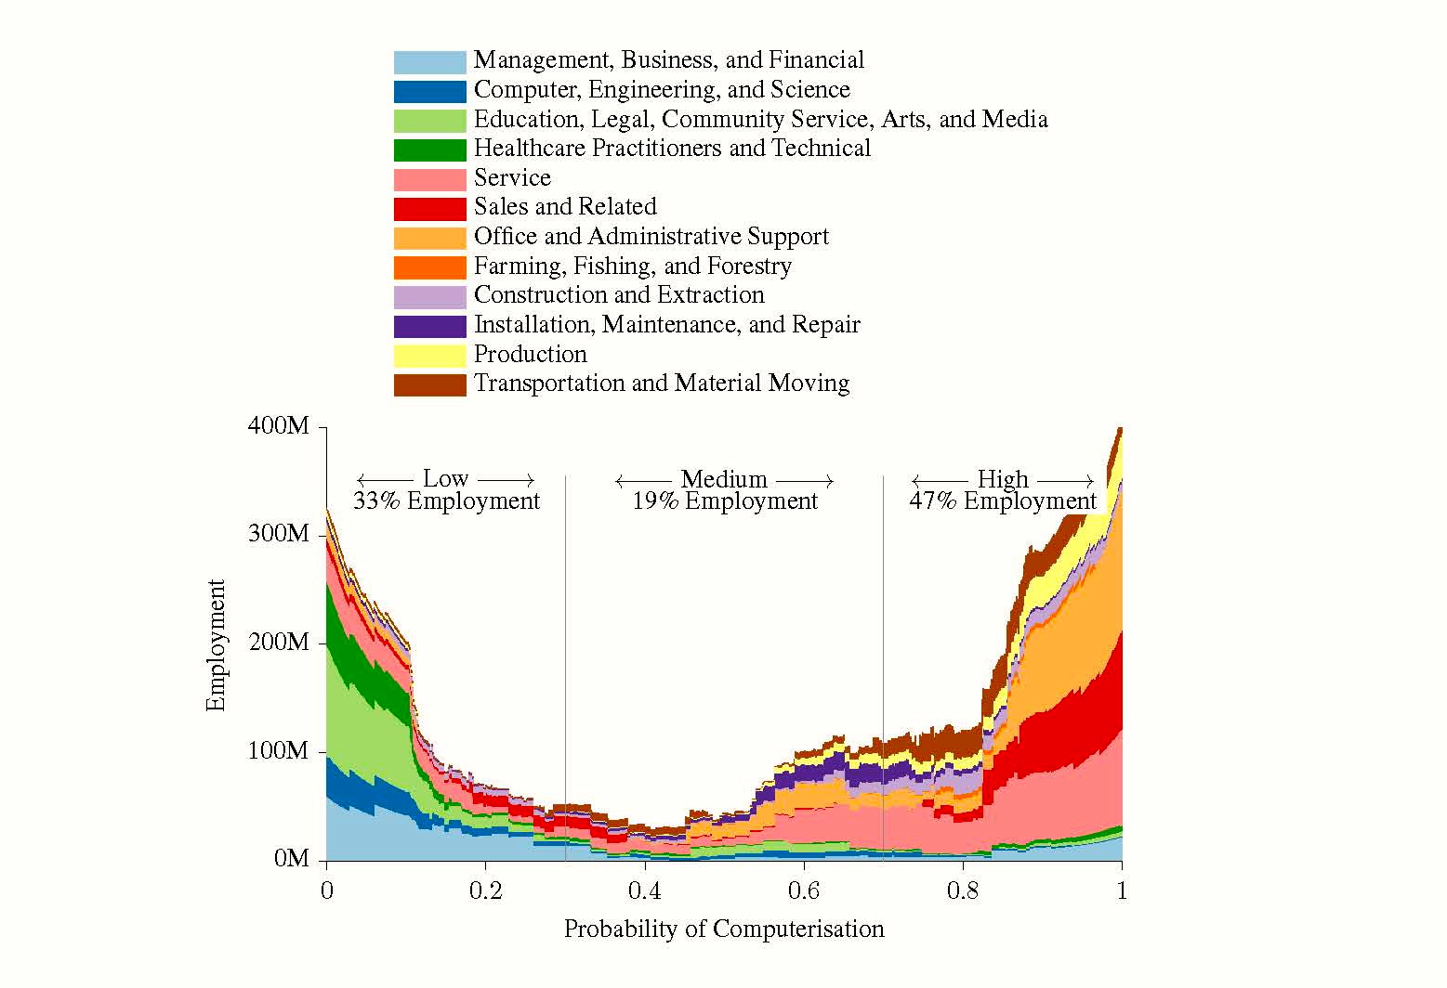
Frey & Osborne (2013)
Notes:
The result of their work is this spectacular graph: almost half of total occupation is likely to be sustituted by digital technologies.

Slide 19
Less extreme views (and estimates)
Arntz-Gregory-Zierahn (2016) estimate job automatibility for 21 OECD countries. They find that, on average, 9% of jobs are automatable.
→ Task-based approach

Slide 20
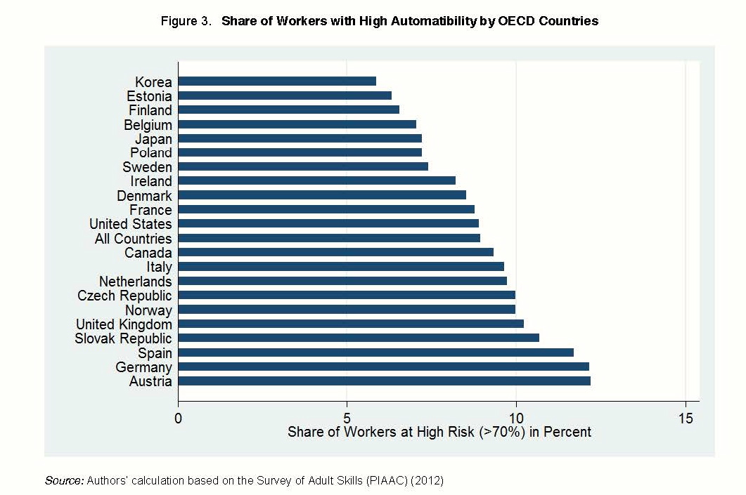
Arntz-Gregory-Zierahn (2016)
Notes:
This analysis is based on tasks, not on occupational categories.
The threasold for high risk of substitution is 70%, like in the study by the Oxford scholars.

Slide 21
5. (Re)connecting workers
Notes:
Let me turn to approaches which give work (and workers) a chance.

Slide 22
5. (Re)connecting workers
Autor (2015):
Automation substitutes labour, but strong complementarities between automation and labour occur that increase productivity, raise earnings, and augment demand for labour.
Technology eliminates jobs, not work.
Job polarisation in recent years is lower than expected (see also Moretti, 2013)

Slide 23
Autor (2015):
Routine tasks, explicit and codifiable tasks, characteristic of many middle-skilled cognitive and manual activities. Increasingly displaced by computers and robots.
→ Substantial decline in employment
Abstract tasks, tasks that require problem-solving capabilities, intuition, creativity, and persuasion. Characteristic of professional, technical, and managerial occupations. High level of education and analytical capability.
Benefit from IT via strong complementarities between routine and abstract tasks
Manual tasks requiring situational adaptability, visual and language recognition, and in-person interactions. Ex. Janitors and cleaners, vehicle drivers, security guards, flight attendants, food service workers, home health aides.
→ No complementarities with IT, but benefit from increased demand for these activities.
Job polarization: tends to reduce in the future
→ Emergence of “new artisans” (Katz, Micelli), middle-skill workers who combine routine technical tasks with nonroutine tasks (interpersonal interaction, flexibility, adaptability, problem solving).

Slide 24
6. Digital revolution, Work-force composition, and Job polarisation i

Slide 25
First tentative conclusion
Job polarisation, yes but… employment (and wage) dynamics are beginning to tell a somewhat different story…
… employment polarization will not continue indefinitely. While some of the tasks in many current middle-skill jobs are susceptible to automation, many middle-skill jobs will continue to demand a mixture of tasks from across the skill spectrum (Autor, 2015).

Slide 26
First tentative conclusion (Autor, 2015)
Job polarisation, yes but …
Polanyi’s paradox—“we know more than we can tell”—presents a challenge for computerization because, if people understand how to perform a task only tacitly and cannot “tell” a computer how to perform the task. (Author, p.24)
This is the key to understand why “so many jobs survive”.
Holzer (2015) documents that “new middle skill jobs” in most economies are growing rapidly.
Notes:
Micheal non Karl

Slide 27
Entrepreneurs, new firms and Industry 4.0 in Emilia
In this theoretical framework new entrepreneurs in in Emilia (and other regions) are:
Either a product of very high level of educational training (Es. top universities). They have high level of scientific and technical education, full control and understanding of (some) new technogies, but also vision, leadership, ….
Or … they are new artisans, sons of the italian tradition in manufacturing, and at the same time, very similar to those depicted by Katz and by Autor.
Notes:
Un autore italiano, studioso come me dei sistemi di piccola impresa, anche a partire da considerazioni simili a quelle di cui vi ho proposto, scrive un volume che ha il titolo emblematico “Futuro artigiano”, come dire non pensate che «grande fabbrica senza uomini», sia la manifattura del futuro.

Slide 28
7. Reconnecting workers (to work) Policy issues
Notes:
If one is against talibans and agrees that in this area market failure are quite possible, «reconnecting worker to work» requires something else.
Better do no be overconfident in the «natural evolution» of technical progress.

Slide 29
Reconnecting workers to work cannot be left to market forces:
Some proposals deserve attention
Basic income (Martin Ford, Erik Brynjolfsson, Robert Reich and Guy Standing)
Education (Erik Brynjolfsson and Andrew McAfee, Ignazio Visco and many others)
Shorter working hours (Wassily Leontief, John R. Commons, John Maynard Keynes)
Broadening the ownership of technological assets (James S. Albus, John Lanchester, Richard B. Freeman, Noah Smith)
But also industrial policies how they have been depicted in this conference
Notes:
I list four.

Slide 30
Reconnecting worker to work: income distribution
John Maynard Keynes’ predicted widespread technological unemployment “due to our discovery of means of economising the use of labour outrunning the pace at which we can find new uses for labour” (Keynes, 1933, p. 3).
In Economic possibilities for our grandchildren (1931), he envisaged a world with no scarcity, short working hours and plenty of leisure.
One of the necessary condition of this construction was a fair distribution of income and low returns to private investment.
We do know that something went wrong
(Piketty and many others)

Slide 31
An even more tentative conclusion
Our world will not be made up only of Google-cars, drones, di Amazon, www, and so on.
There are opportunities for using abilities and competence not subject but complementary to digitalization and automation (up to now …).
I believe that in the Third Italy, in the regions where Industrial Districts had and have an important role, there is plenty of space for «the human use of human being» (quoting Norbert Wiener).
Thanks for your attention !!!

